Slide 1
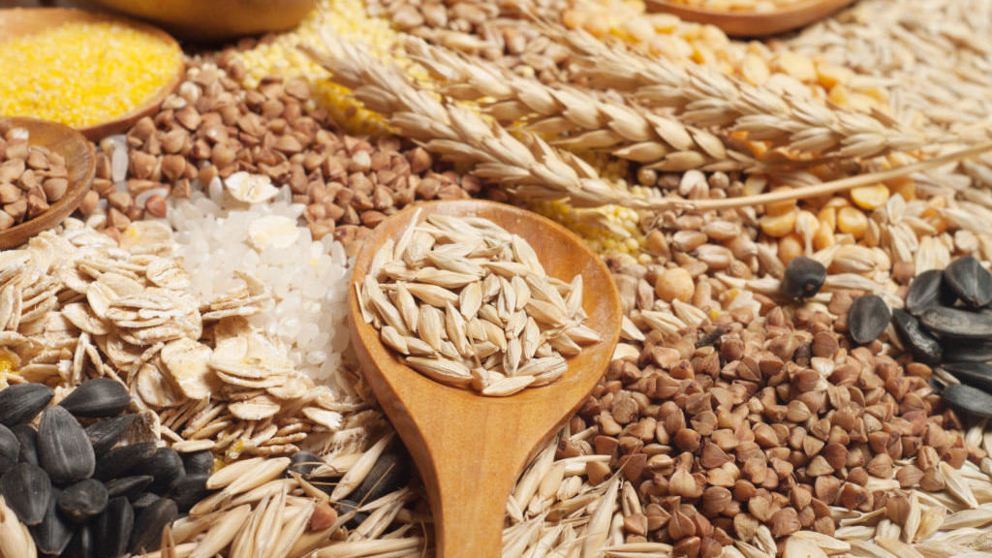
Cereals in Dalmatian region
NINA ŠUBAŠIĆ 8.A.

Slide 2
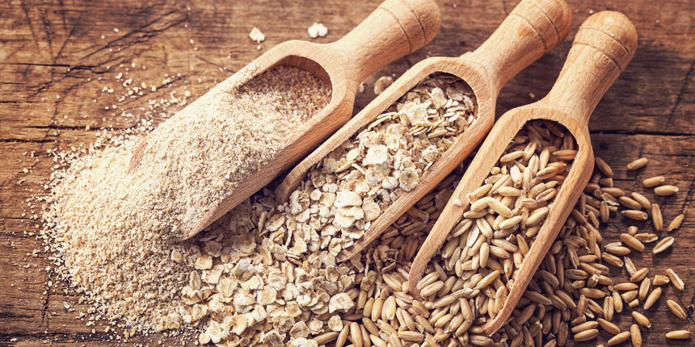
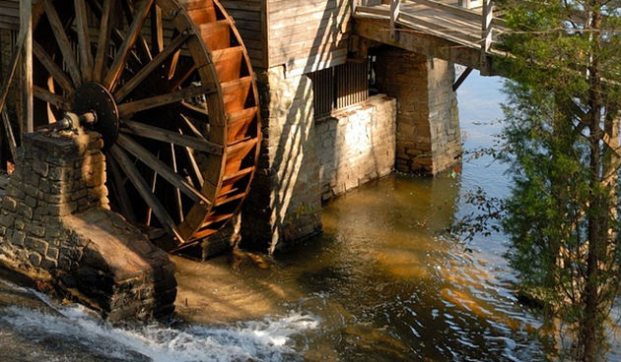
Cereals in Dalmatia (in past)
They covered all surfaces in Dalmatia
Many mills were located on underground rivers

Slide 3
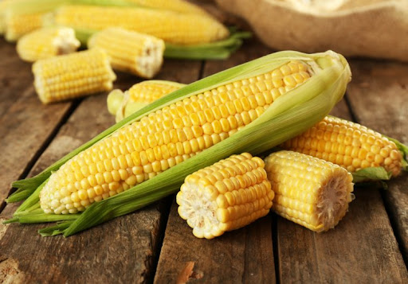
They were planted because…
In the old time people were mostly fed by planting
Cereal was one of the most important crops they planted
In Dalmatia , they mostly planted maze

Slide 4
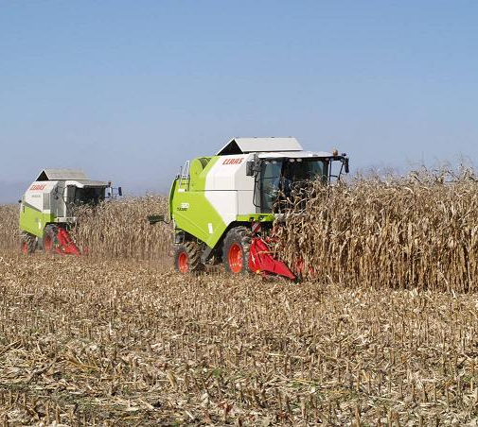
Why did they stop planting?
It hasn’t taken long for people to start producing and selling it in enough amount
It became easily available

Slide 5
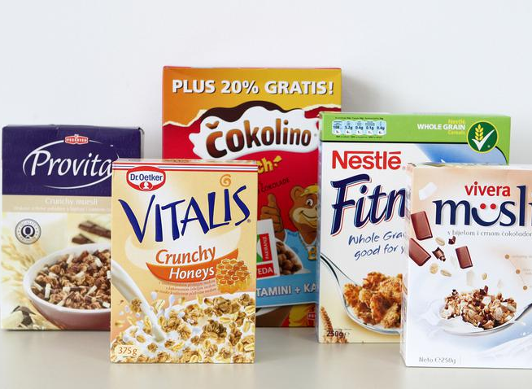
Cereals now
Now you can buy it everywhere, it is easy available and not expensive
There are more flavours and a lot of brands

Slide 6
Photos from:
https://bauerfeind.hr/upload/publish/97/thumb/shutterstock-227784439-1024x684_5d8def8bac194_1200x645c.jpg
https://d35nxk5xx1d0px.cloudfront.net/repository/images/_variations/b/d/a/a/bdaacee7df4cce39abd59e5663597c82_view_article_new.jpg?v=22
https://d35nxk5xx1d0px.cloudfront.net/repository/images/_variations/5/6/c/7/56c719031b034976005fd84ba7aac38c_view_article.jpg?v=20
https://lh3.googleusercontent.com/proxy/e3h4t5lRzyDY65o40g-9AIm7K4hXJ1bEglF-kEq87ZtFuAppQ5HjMNbyrJYB4mqgMbjP9RpP_vwJ0uBRBRnfiufIC_mmTrD-kYD319_FH6d-kw
http://rwa.hr/wp-content/uploads/2012/02/kombajniranje-kukuruza4.jpg
https://miss7zdrava.24sata.hr/media/img/9a/bf/51f2ae9c9027e1f54561.jpeg
https://memegenerator.net/img/instances/80721960.jpg

Slide 7
The end
This is end of my little report about cereal.
I hope you enjoyed. Thanks for your time

