Slide 1
TRADITIONAL CEREALS OF MY AREA-DALMATIA
Marin Pleština 8.a

Slide 2
CORN
It is originally from Central America
Came to Europe in 1493. and to Croatia in 16-th century
We get flour from it, popcorn and sweet corn

Slide 3
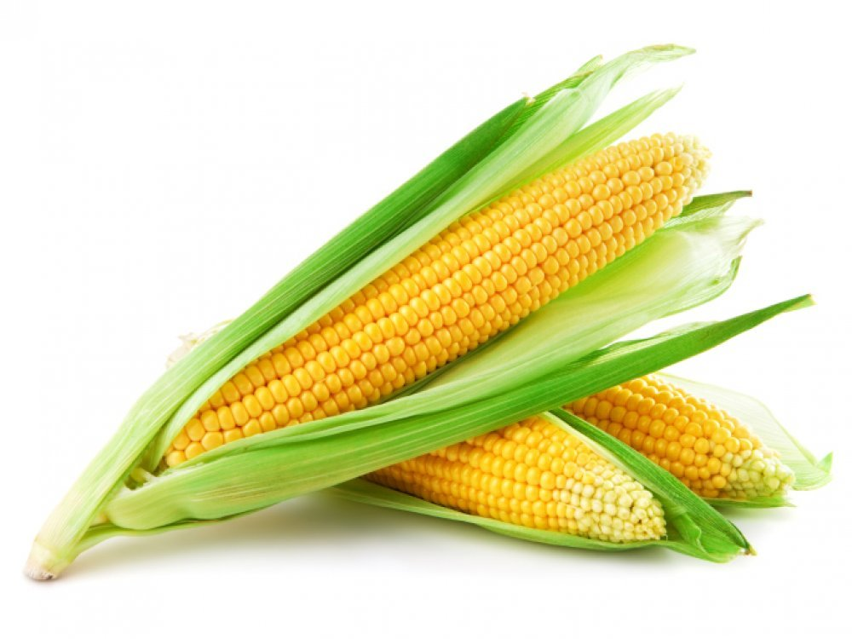

Slide 4
WHEAT
It is used to make flour for bread, cakes and pasta
It is also used to make beer, alchol, vodka and biofuels

Slide 5
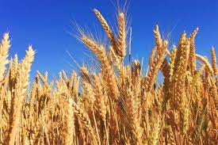

Slide 6
BEANS
Originates from America where it was bred 4000 years ago
Came to Europe in the early 1500s
Matures in Autumn

Slide 7
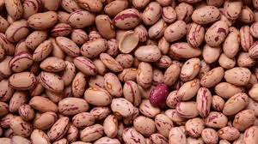

Slide 8
BARLEY
Comes from the grass family
Originates from Eurasia
It can grow up to 1 meter
It is used in food and in brewing, it is also medicinal

Slide 9
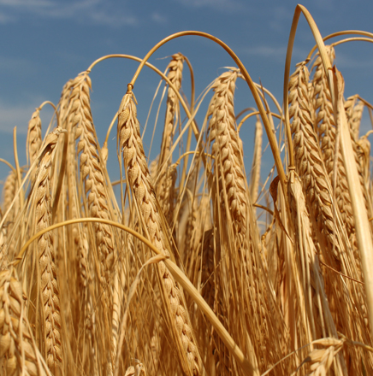

Slide 10
THE END

