Slide 1
Klis fortress
marija vetma 7.a

Slide 2
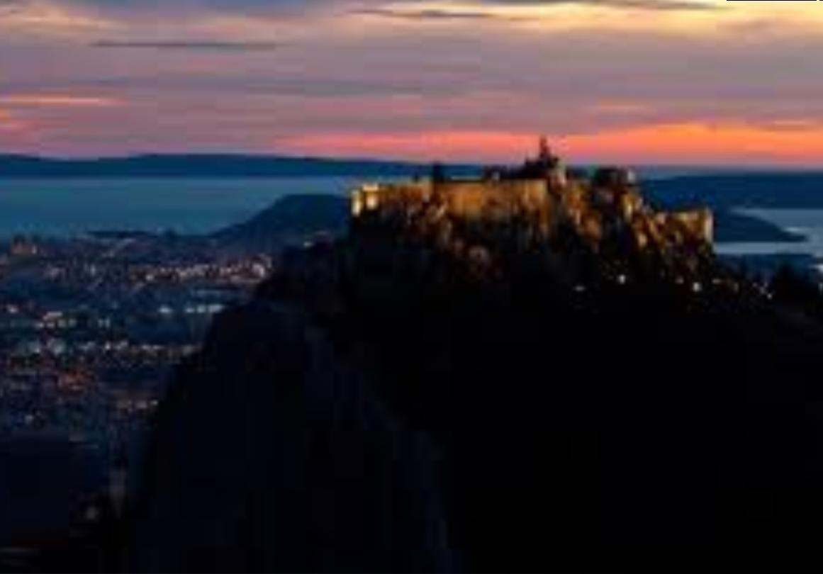
Interesting facts about the klis fortress
Klis fortress is one of the most complete examples of fortication architecture in Croatia.It is located in strategically important position on the eponymous town of Klis in Split-Dalmatia county ,located on the junction between Kozjak on the west and Mosor on the east.

Slide 3
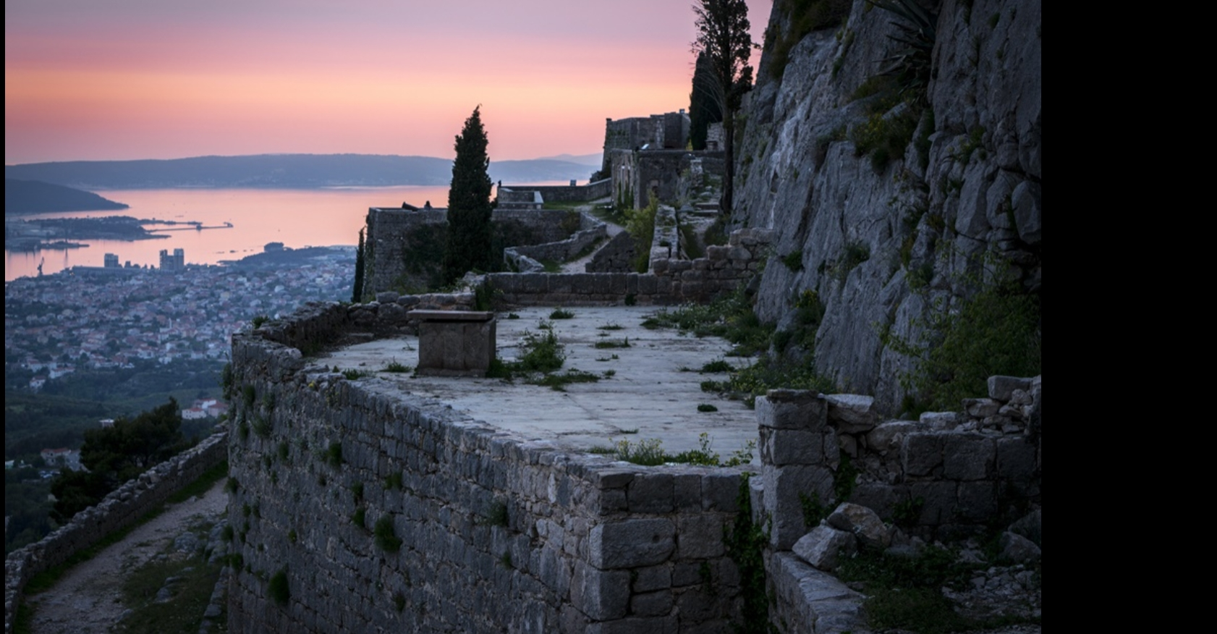
Battle of the fortress
At the beginning of 1527 the Ottomans captured Obrovac and Udbinu.The only fort south of Velebit that remained in Croatian hands was Klis in the hinterland of Split.The defense of Klis was led by Petar Kružić.After capturing the fortress the Turks executed the heroic captain on March 12. Petar Kružić.

Slide 4
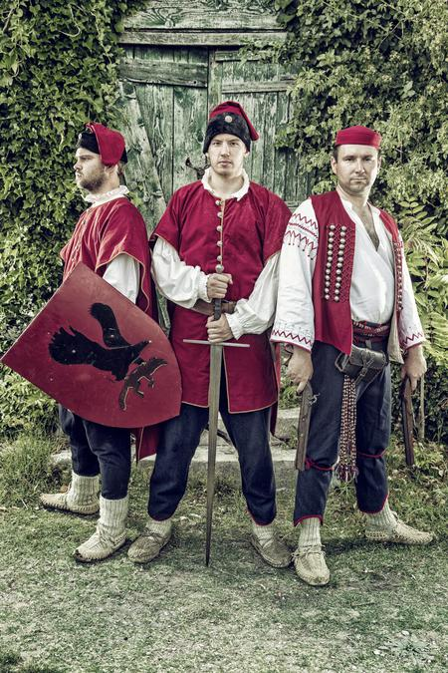
A traditional medival festival
Every year in july a traditonal medival festival called „Uskok Battle for Klis” is held .Here,the Klis Uskoks are dressed in medival uniforms.

Slide 5
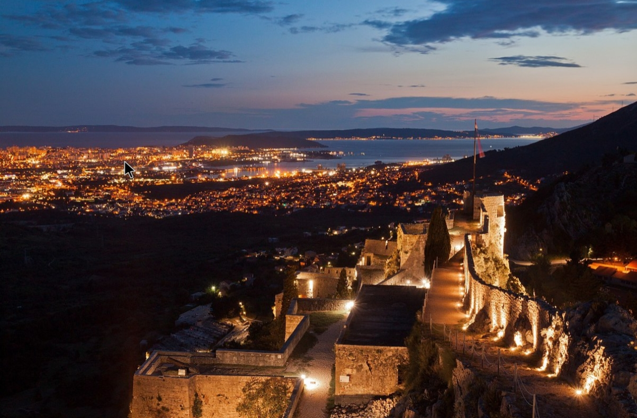
Defense of the fortress
Petar Kružić and uskoks in many occasions successfully defended Klis from Ottoman attacks in the period from 1515 until 1537.

Slide 6
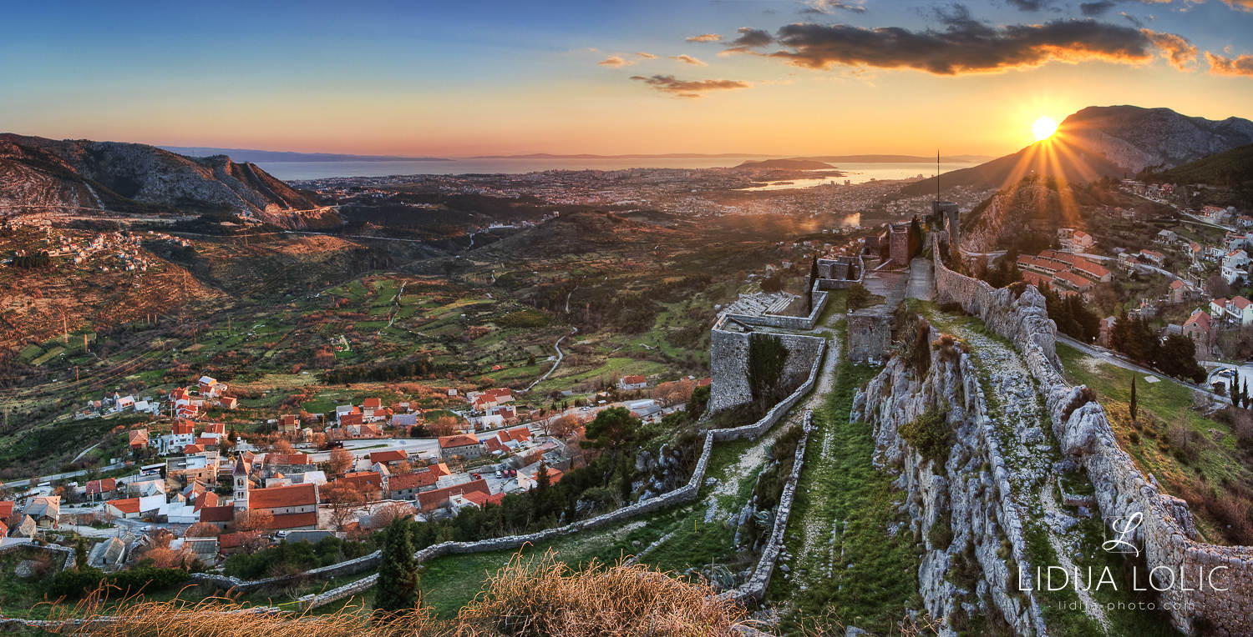
the end
By:Marija Vetma
Text :wikipedia

