Slide 1
Elementary school Petra Kružića Klis
Paulina Krolo, 7.a
This is Elementary school
Petra Kružića Klis

Slide 2
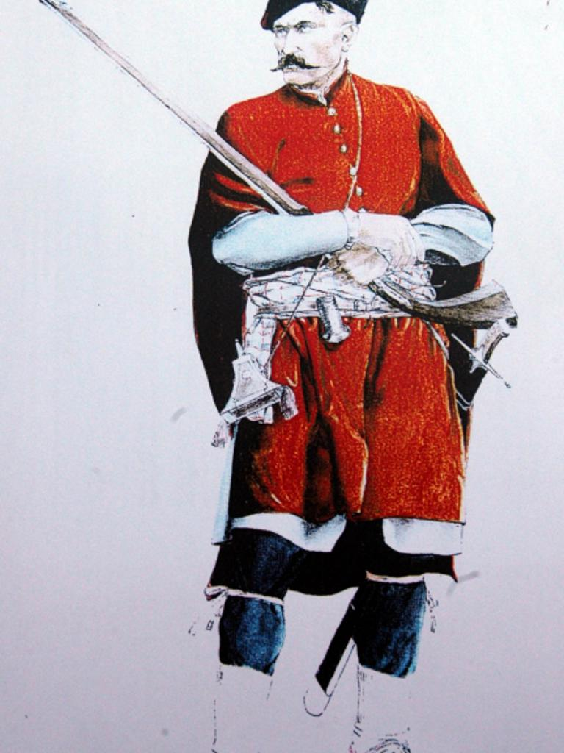
How did that school get its name?
- The school was named after Petar Kružić
(We will find out more about Petar Kružić on the next slide)
-In the picture you can see Petar Kružić

Slide 3
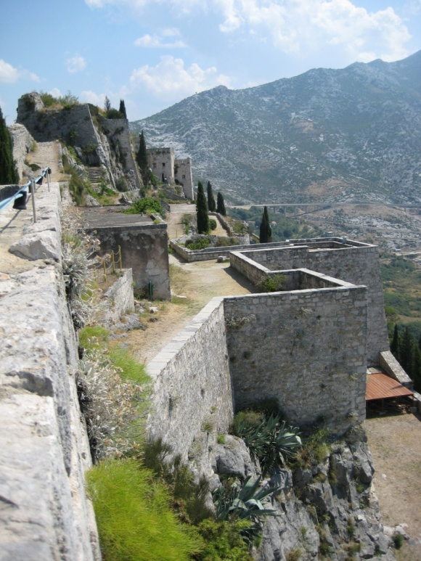
Who is Petar Kružić?
-Petar Kružić was a Croatian general and captain of Klis
- One of the most important Croatian warriors in the wars with the Turks
-He died in the Turkish conquest of Klis
- He was born on October 16. 1491.
-Died March 12. 1537.
-This is
Klis Fortress the
Turks wanted to conquer

Slide 4
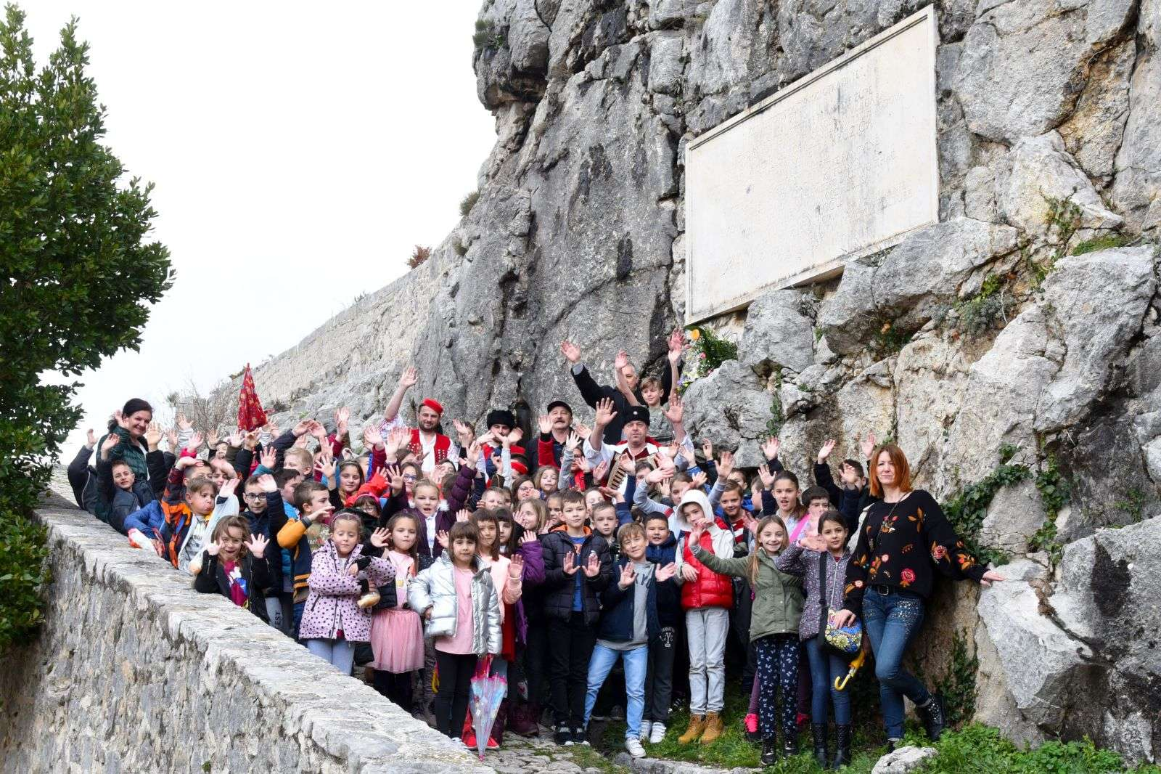
SCHOOL DAY
We celebrate Petar Kružić Elementary School Day on March 12.
Because Petar Kružić was killed on that date
We always go to the fortress for School day

Slide 5
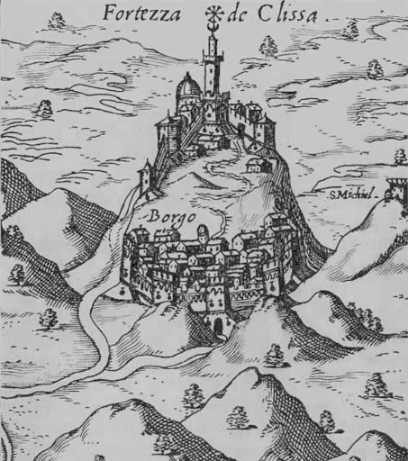
CURRENT SITUATION
Because of corona virus, we couldn’t celebrate our School day the way we usually do
But it didn’t stop us making drawings, singing songs, etc. about
the fortress, Petar Kružić…

Slide 6
Izvori informacija:
-os-pkruzica-klis.skole.hr
-hr.wikipedia.org
Izvori slika:
-vecernji.hr
-sh.wikipedia.org
-klis.hr
-old.skolskiportal.hr
-kliskiuskoci.hr

