Slide 1
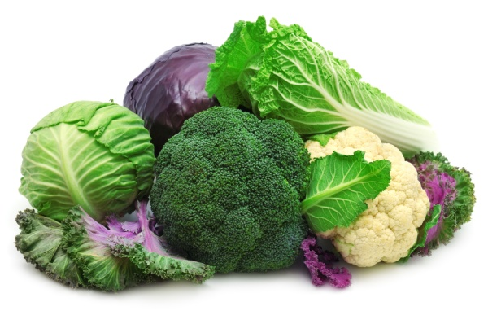
CABBAGE

Slide 2
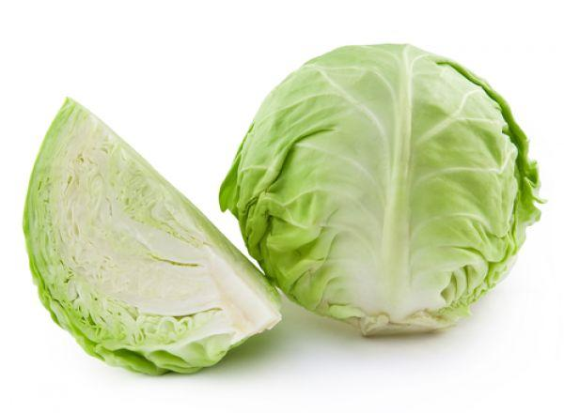
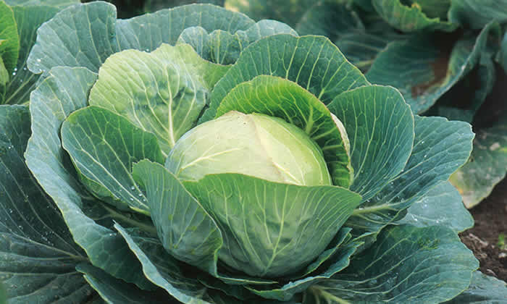
Cabbage
Cabbage is a biennial plant grown as an annual vegetable
It can be green, purple or white
It can be prepared:pickled, fermented, steamed, stewed, raw or braised

Slide 3
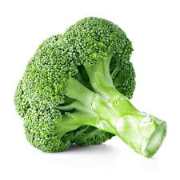
Broccoli
Broccoli is an edible green plant in the cabbage family
It has large flowering head and stalk
It can be eaten raw or cooked

Slide 4
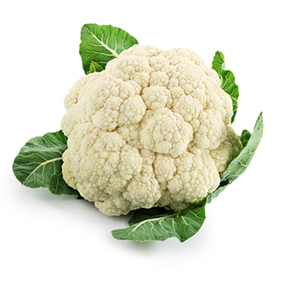
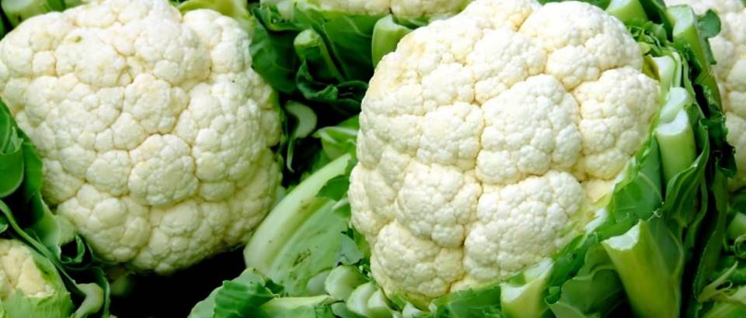
Cauliflower
Cauliflower is an annual plant reproduced by seed
Only head is eaten
It can be roasted, grilled, boiled, fried or eaten raw

Slide 5
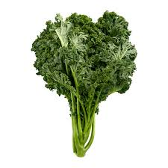
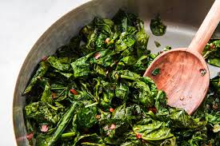
Kale
Kale is one of certain cultivars of cabbage
Kale plants have green or purple leaves
It has been produced as a potato chip substitute

Slide 6
THE END
Made by: Marin Vetma, Stipe Uvodić i Slaven Sikirica-Siky

