Slide 1
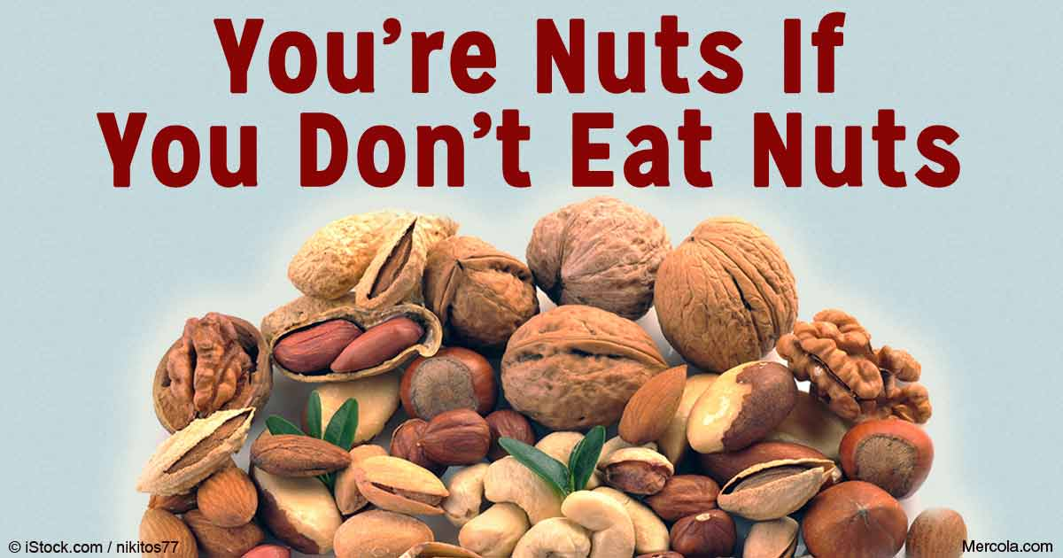
NUTS

Slide 2
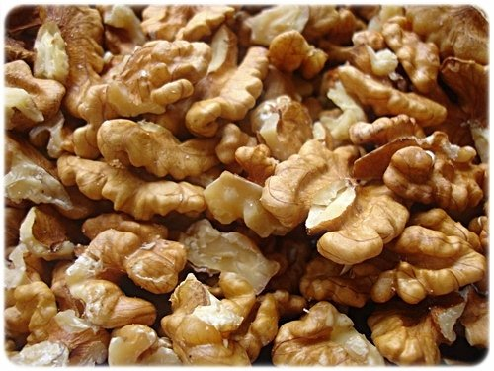
ABOUT
A nut is a fruit composed of a hard shell and a seed, which is generally edible.
All kinds of nuts are edible, but nuts which we usually eat comes from the Persian walnut, the only type that has a large fruit and a thin shell.

Slide 3
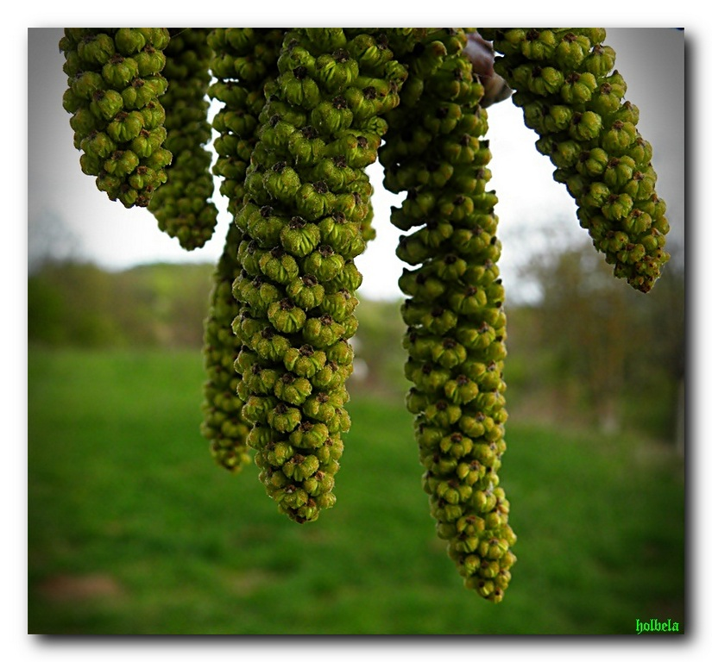
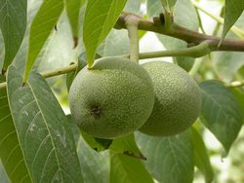
FLOWERS
The flowers are small, blooms before leafing in April and May, and the fruits ripen in October. The fruit of the walnut is round stone fruit, wrapped green, juicy and bitter shell.

Slide 4
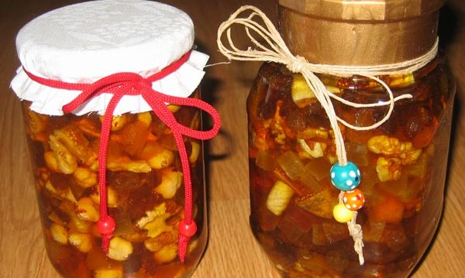
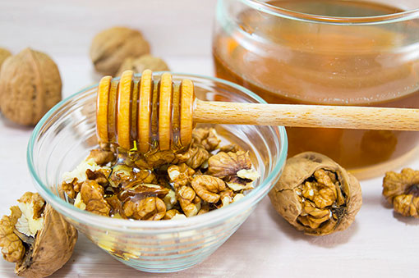
HEALING
The amount of only 30 g of various fruits daily can significantly improve your health.

Slide 5
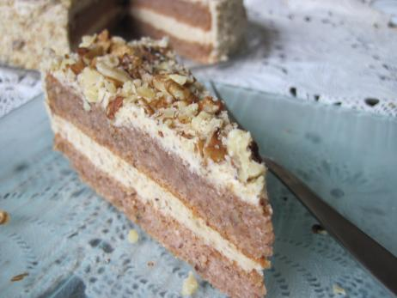
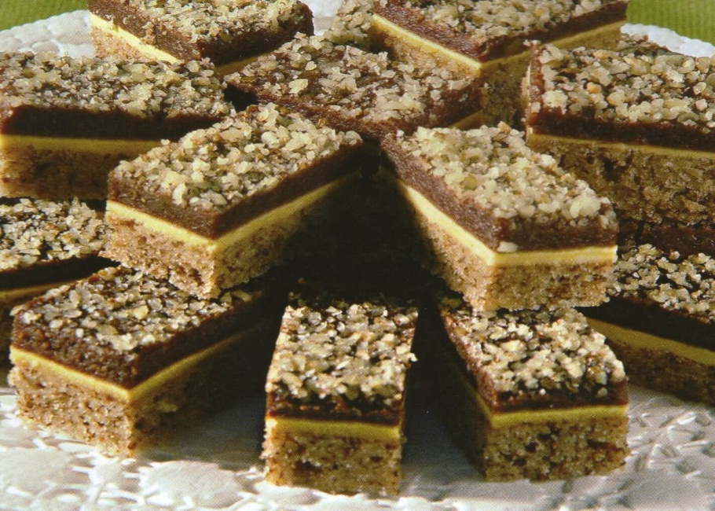
SOME MEALS WITH NUTS
Viennese cake with nuts cubes with nuts

Slide 6
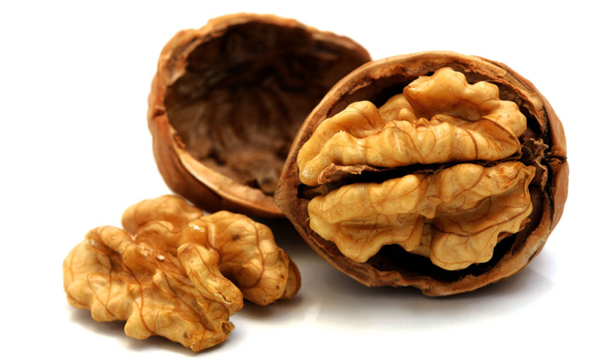
SOURCES
https://en.wikipedia.org/wiki/Nut_(fruit)
https://www.google.hr/search?q=prevoditelj&oq=prevoditelj&aqs=chrome..69i57j69i61l2.3964j0j7&sourceid=chrome&ie=UTF-8
By: Bruna,Dora,Lara & Marta

