Slide 2
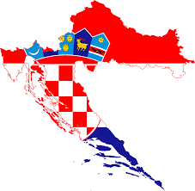
Croatian history

Slide 3
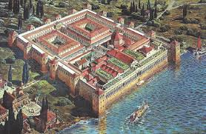
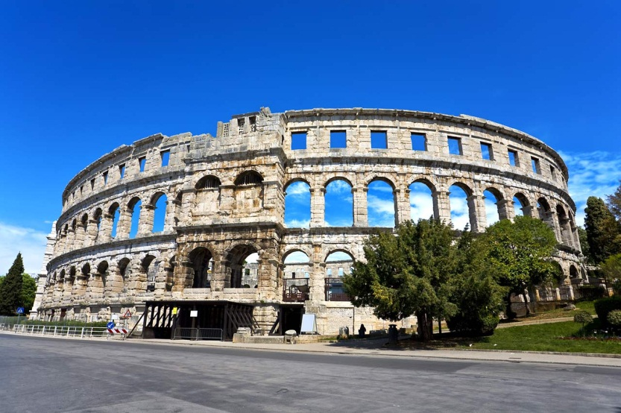
Croatian history
Croatia have a long and great history
Many countries wanted to win Croatia
In Croatia, Diocletian have had a palace and he died in Split
Roman empire was built arena in Pula
Turks attacked Croatia and tried to conquer the fortress Klis "the key of Dalmatia„
Croatia was first mentioned in the seventh century

Slide 4
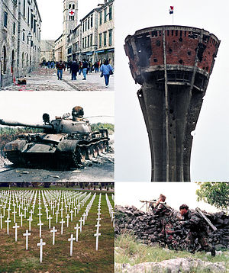
Croatian War of Independence
Croatia wanted to get out of Yugoslavia and become an independent . War began in 1991 and ended in 1995 between Croatia
and Serbian. Croatia won and become independent.

Slide 5
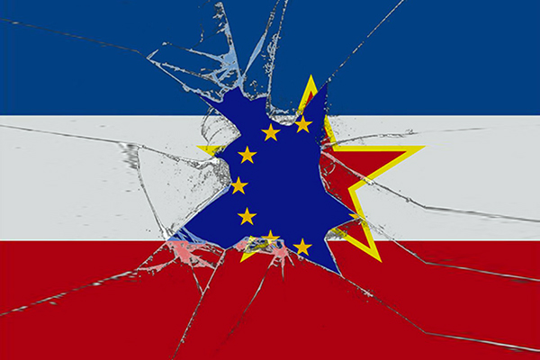
Croatia in eu
Croatia became member of the European union 1. July 2013.
Official candidate in early 2004.

Slide 6
dubrovnik
Dubrovnik has high walls of defense to protect city from attacks from the sea and land.
Dubrovnik has always been an independent republic.

Slide 7
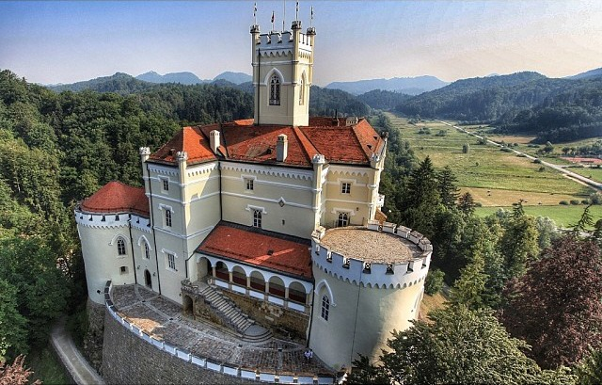
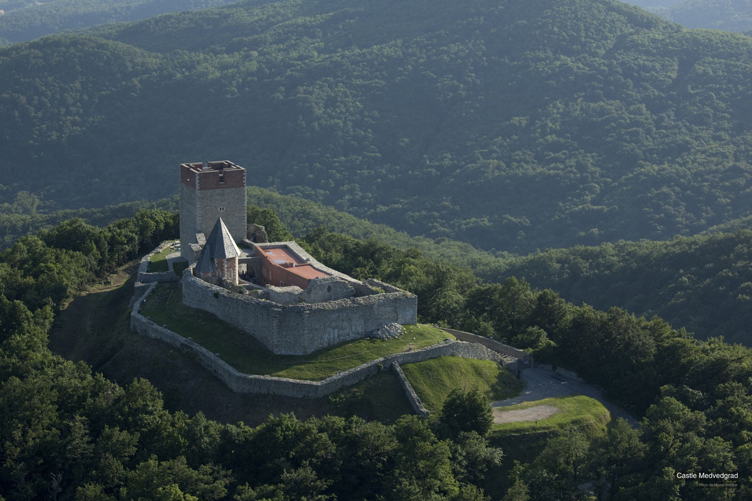
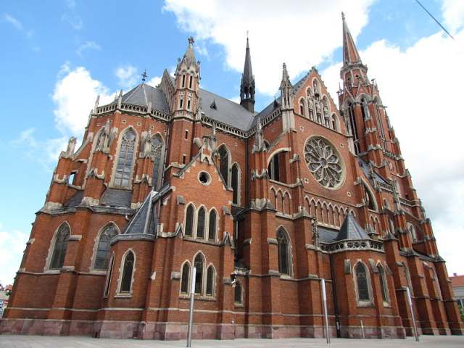
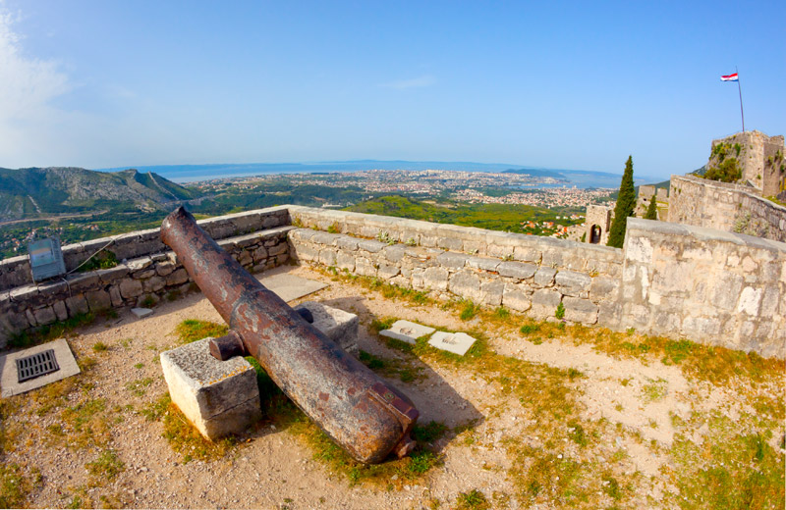
P
I
C
T
U
R
E
S

Slide 8
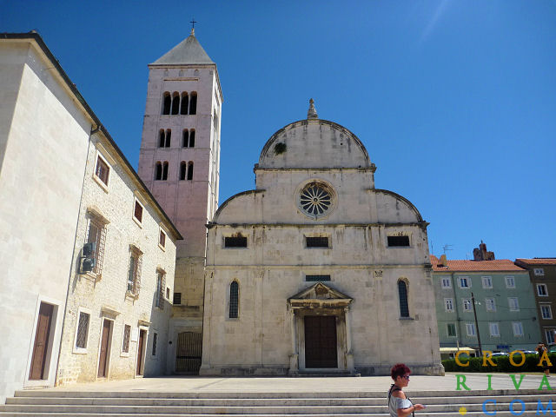
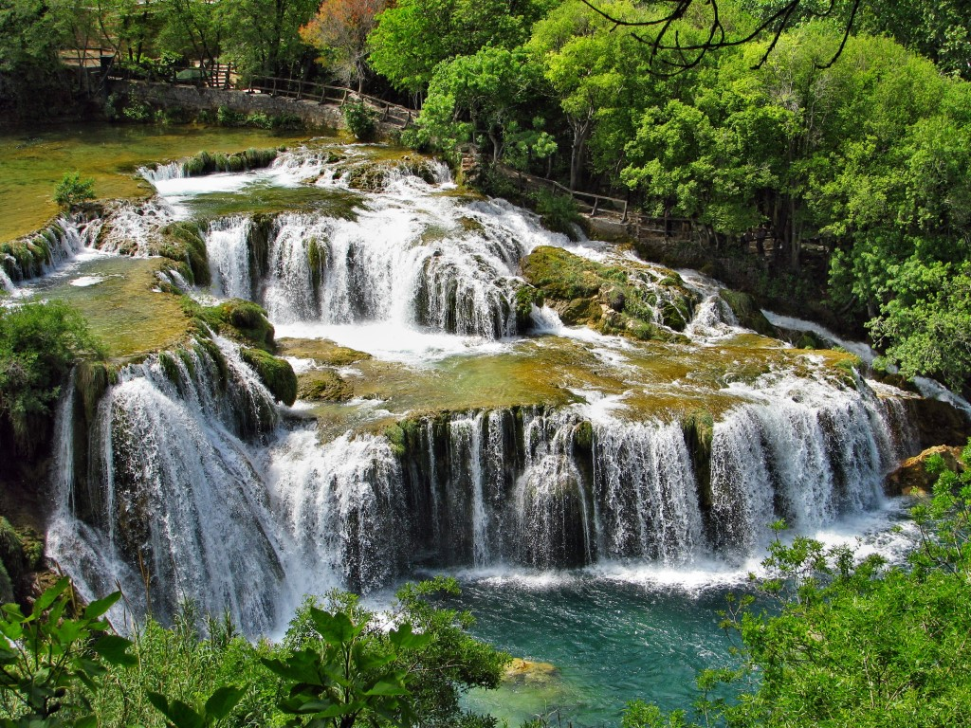
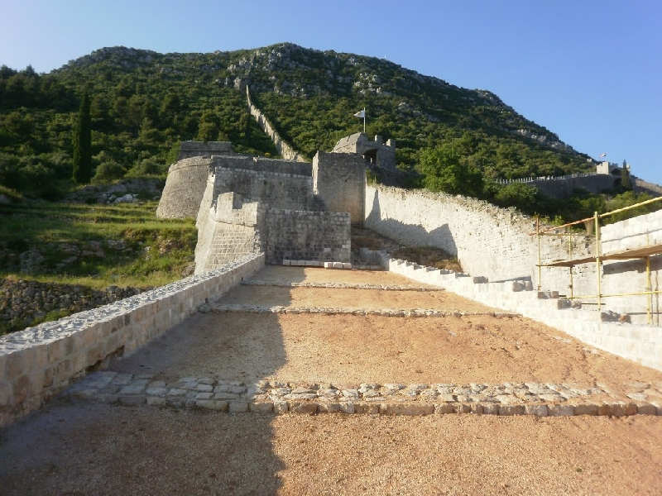
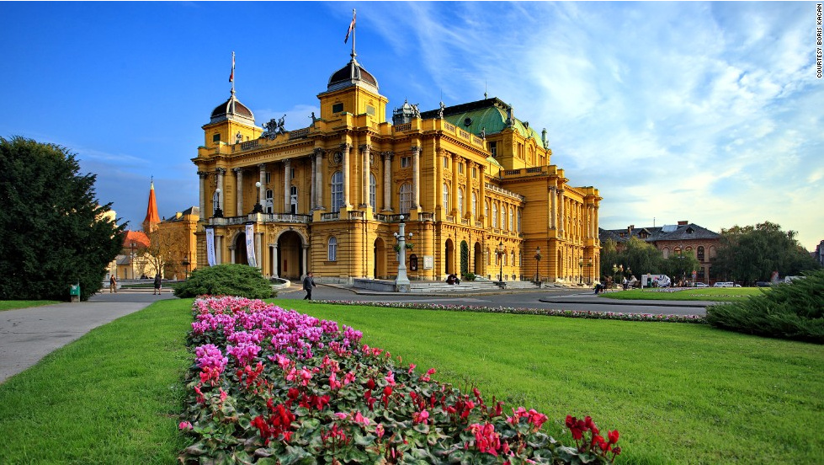
P
I
C
T
U
R
E
S

Slide 9
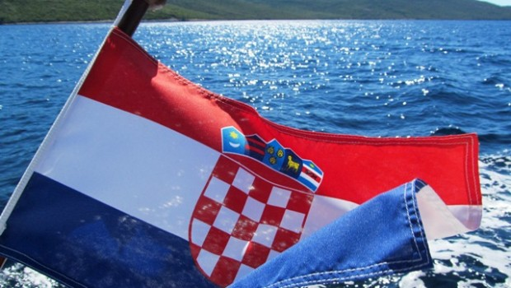
Created:
Stipe Boban
Ante Listeš
8.a.

