Slide 1
PUMPKINS

Slide 2
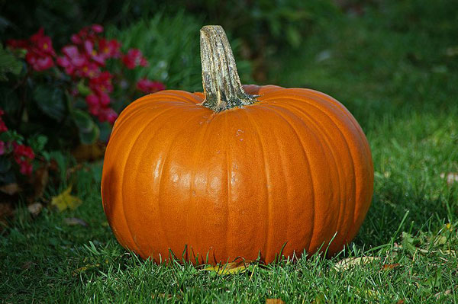
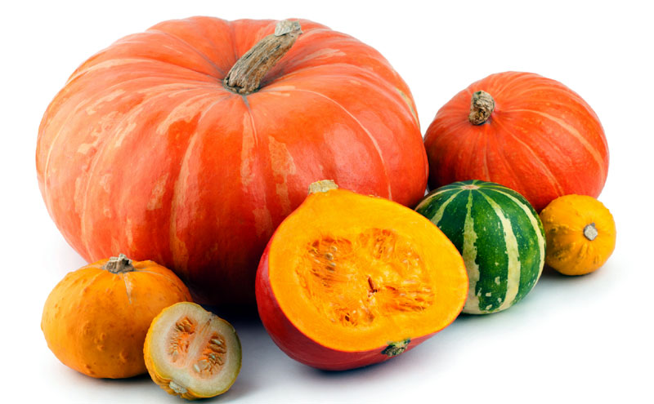
There are various types of pumpkins.

Slide 3
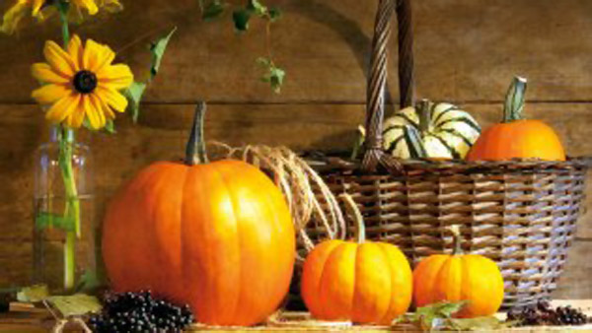
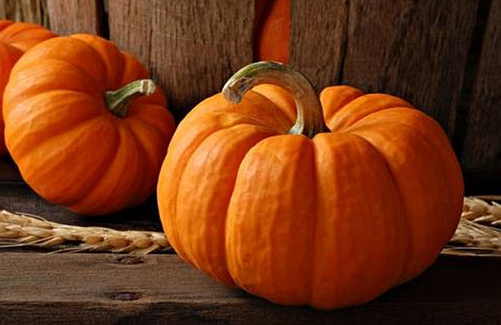

Slide 4
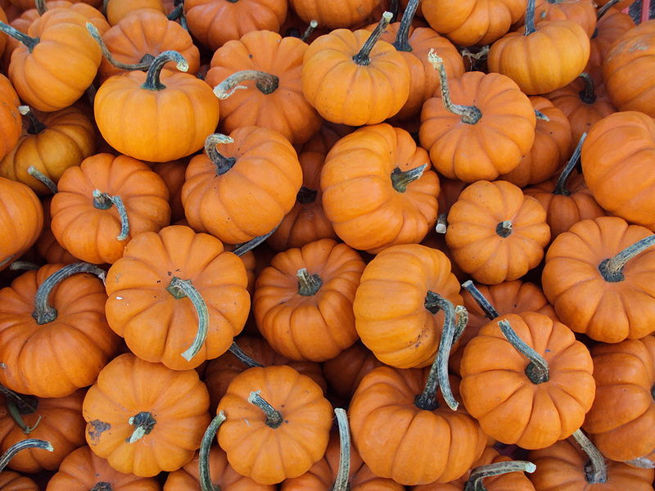
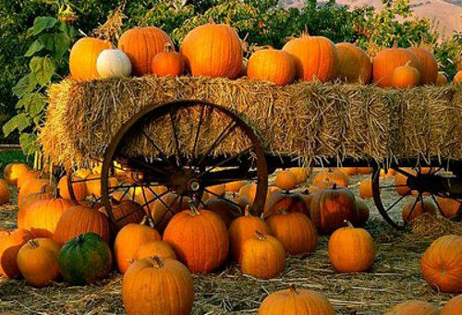
The color of
pumpkins is derived
from the orange
pigments .

Slide 5
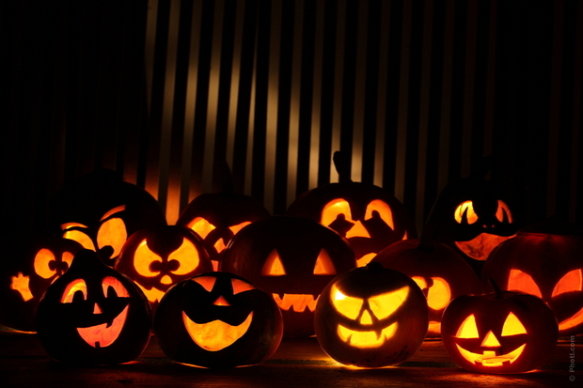
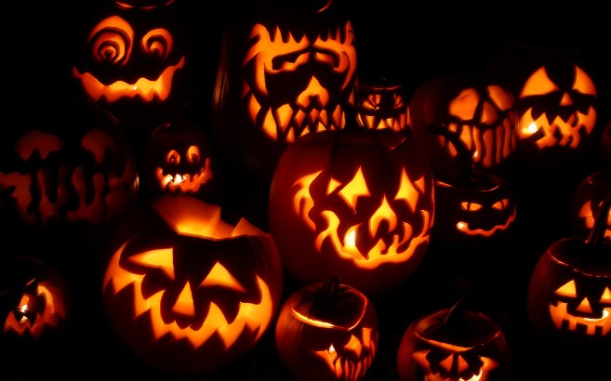
HALLOWEEN PUMPKINS
PUMPKINS ARE CUT

Slide 6
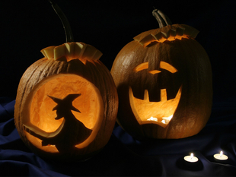
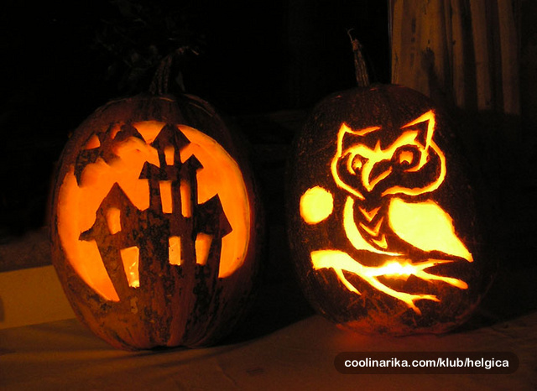
Pumpkins are commonly
carved into decorative
lanterns called
jack-o'-lanterns for the
Halloween season in
North America.

Slide 7
