Slide 1
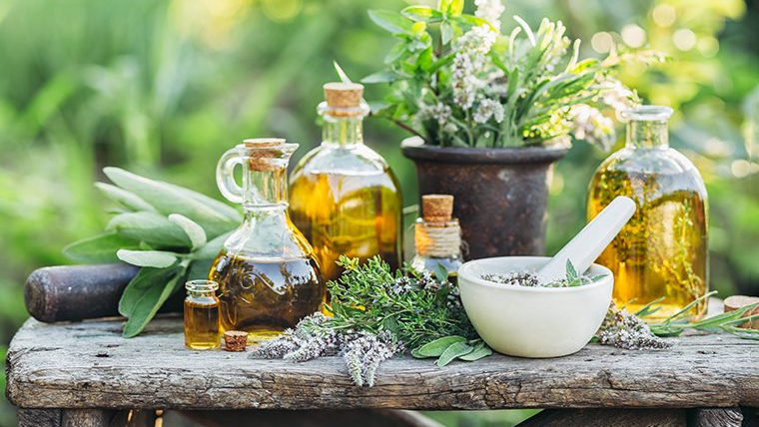
Medicinal herbs
Iva Žižić 6.b

Slide 2
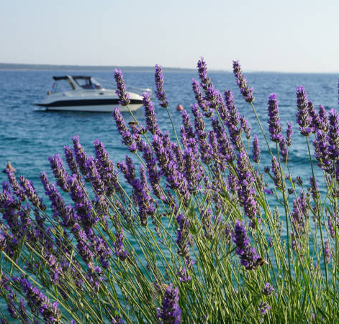
Lavander
Lavender flowers are often used for their healing properties and fragrance
It is a traditional medicine for calming down insomnia and headaches
Lavender can help with minor burns and insect bites
Repels mosquitoes, moths, fleas and flies

Slide 3
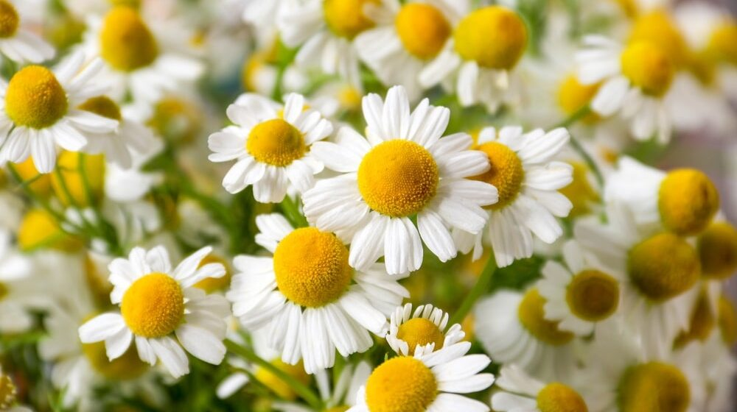
Chamomile
Chamomile has a yellow center and lovely white petals
Chamomile is recommended for patients suffering from stomach disorders and cramps
It also works against pain, inflammation, insomnia, nervousness, poor digestion, skin diseases.

Slide 4
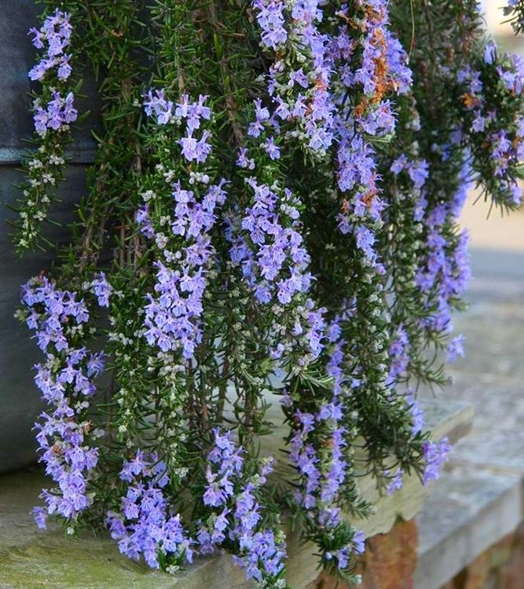
Rosemary
It grows in the form of a bush, has evergreen needles and light blue flowers
It helps prevent cancer and improves memory
It is known as an essential oil and a spice in the kitchen

Slide 5
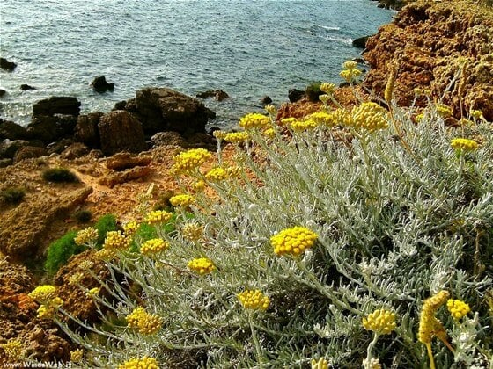
Immortelle
They are called flowers that do not wither even when picked
Immortelle grows in Mediterranean regions, especially on sunny rocky areas
It grows to a height of 60 cm, has narrow leaves and yellow flowers
It is traditionally used to help with asthma, migraine, liver problems and skin diseases.

Slide 6
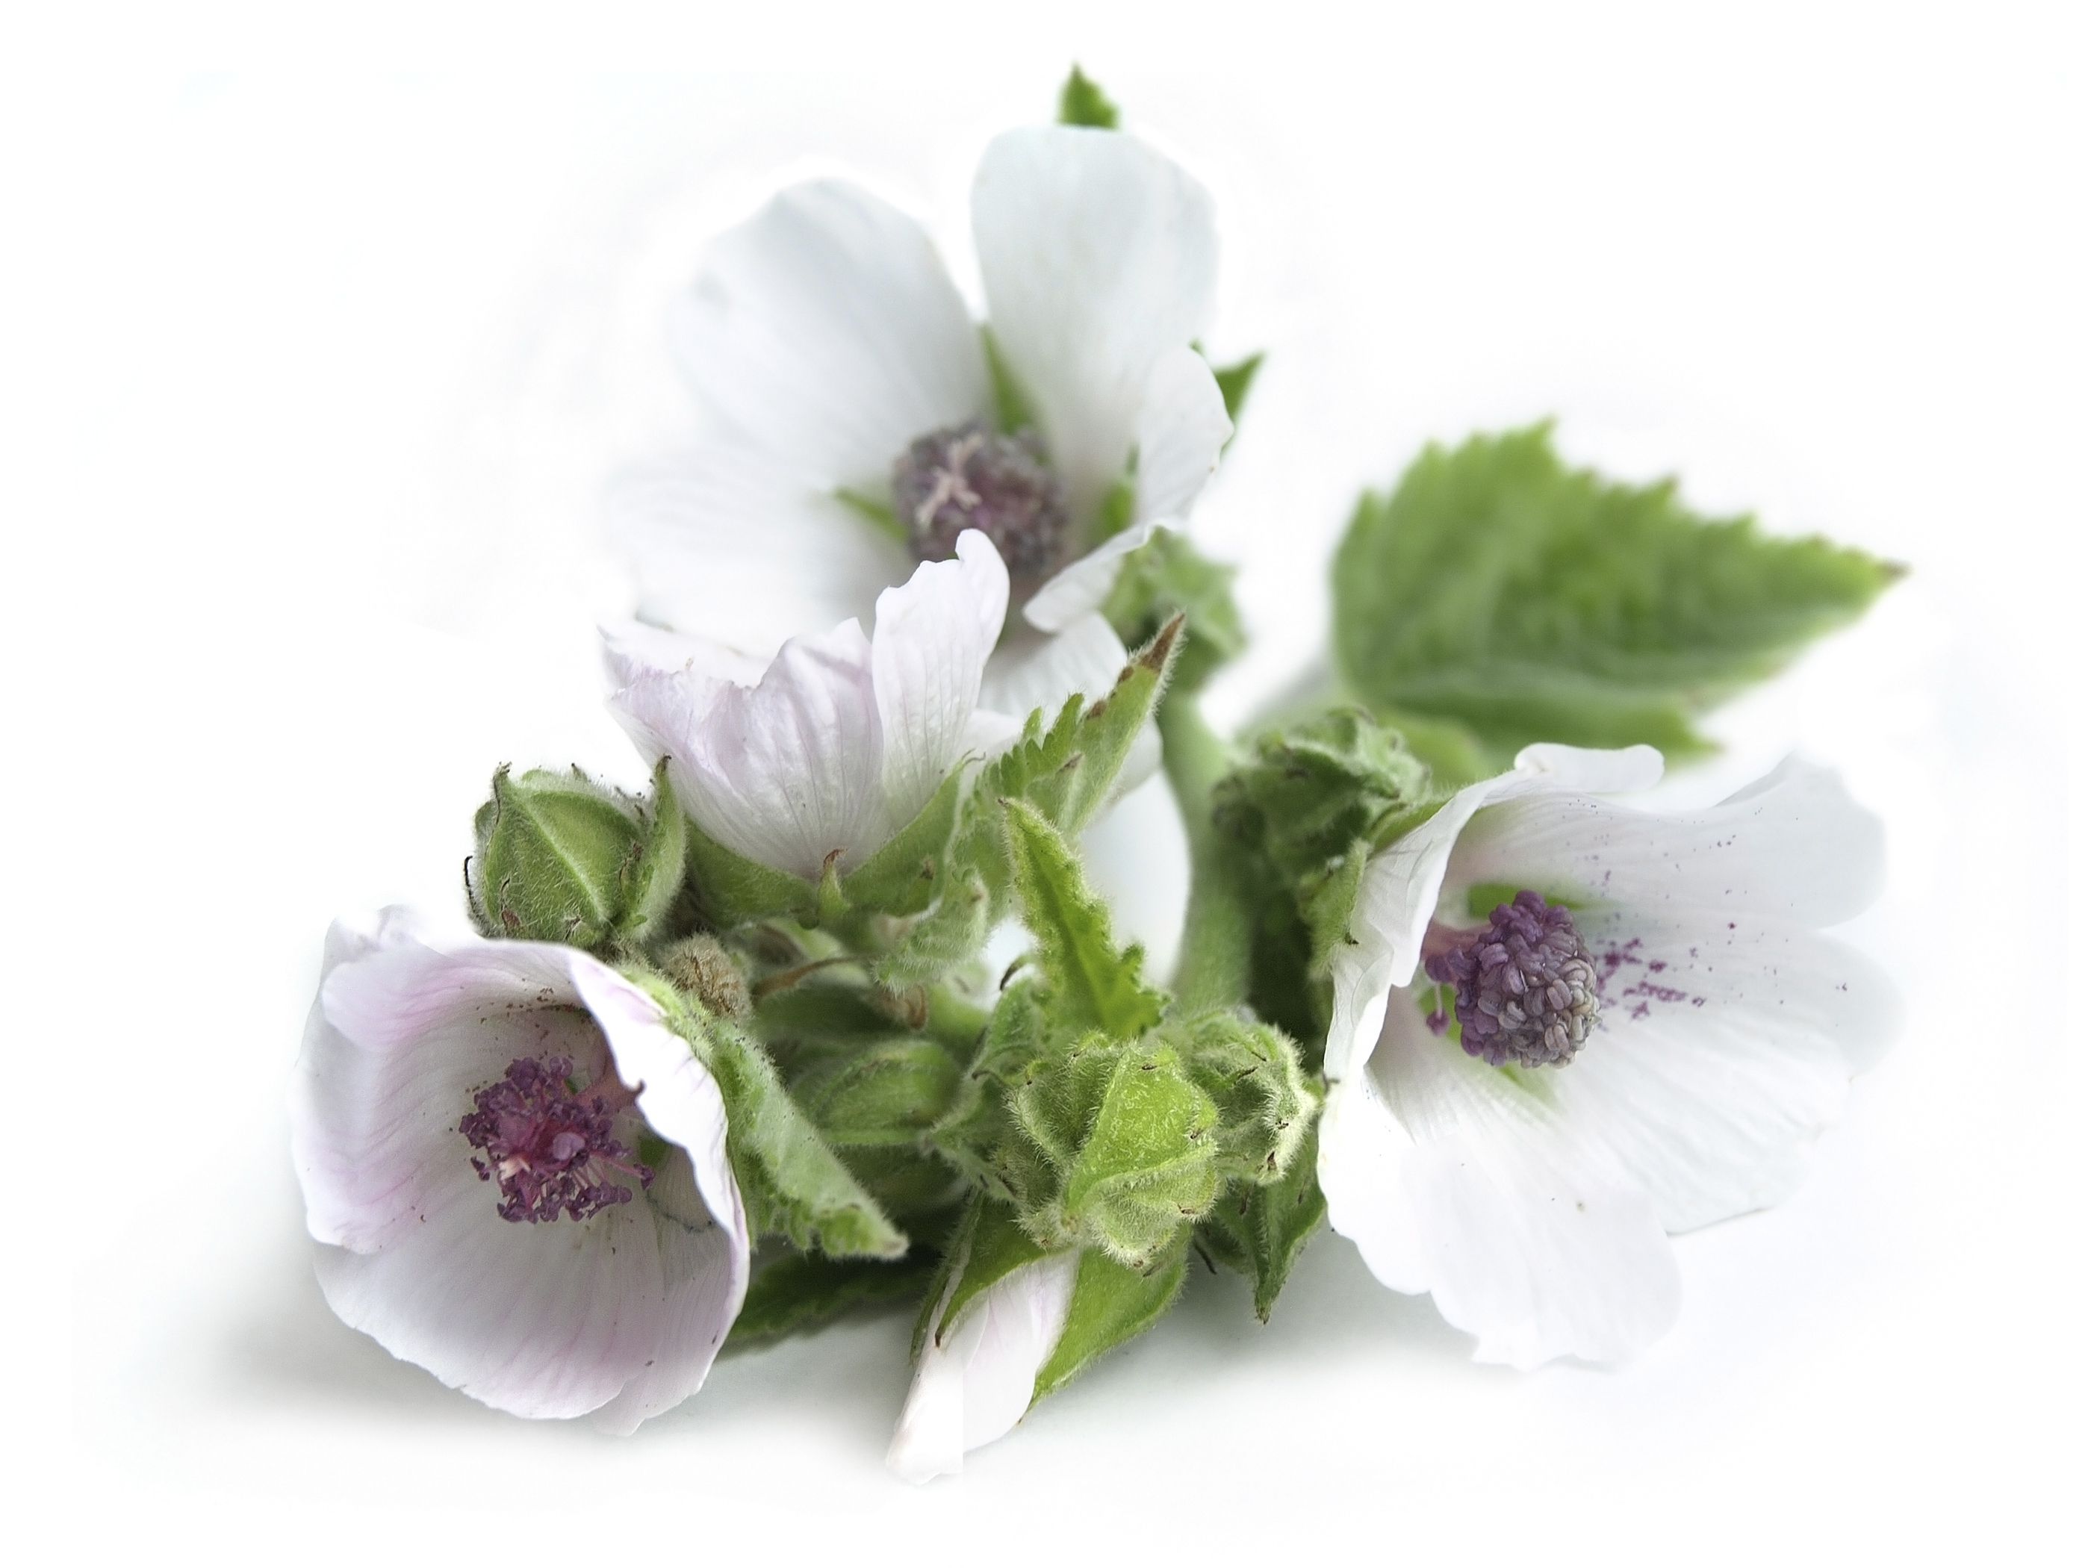
Marshmallow
- Medicinal parts of the plant are the root, leaves and flowers, and the most commonly used parts of mallow in medicine are the root and leaf.
Mallow is used to relieve coughs and throat infections

Slide 7
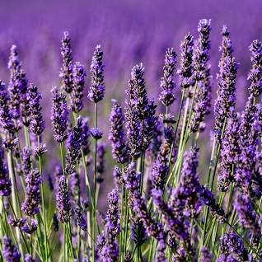
Sources
https://www.istockphoto.com/photo/purple-lavender-flowers-and-blue-sea-with-boat-in-the-background-gm980384490-266341272
https://www.danas.rs/zivot/zdravlje/za-sta-je-sve-lekovita-kamilica/
https://rasadnikmalivrt.rs/product--puzajuci-ruzmarin
https://krenizdravo.dnevnik.hr/zdravlje/alternativna-medicina/biljna-ljekarna/smilje-uzgoj-sadnja-otkup
https://shopsale.cheapdiscount2023.com/category?name=ljekovita%20biljka%20krusina
https://encrypted-tbn2.gstatic.com/licensed-image?q=tbn:ANd9GcQ_8wbdX_7dB_ihld1FW3bG4PZhdTkb3yPmJV1N09KekoLElbonB4ksu2G6ygBldt5isc7nJtqsH2Aunh8

Slide 8
Thank you for your attention

