Slide 1
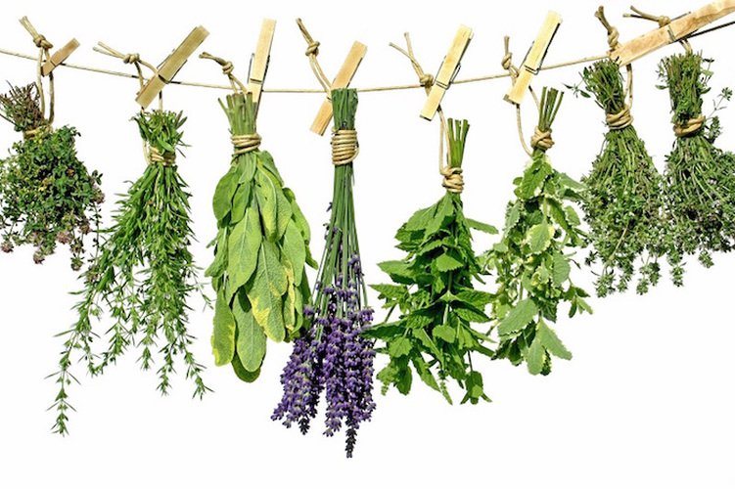
MEDICINAL HERBS
Teacher: Marijana Buljan
ANTONIO MALEŠ, 8.A

Slide 2
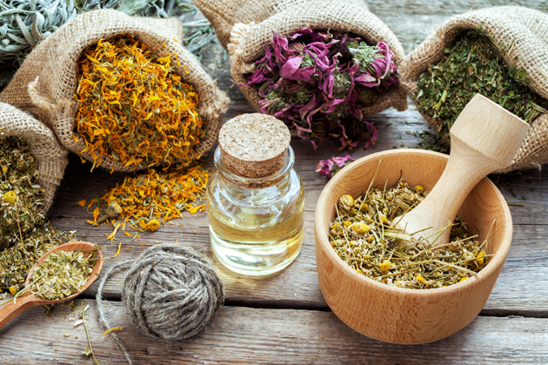
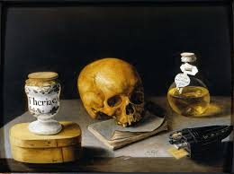
HISTORY OF MEDICINAL HERBS
Medicinal herbs, have been discovered and used in tradicional medicine practices since prehistoric times.
In the Early Middle Ages, Benedictine monasteries preserved medical knowledge in Europe
Medicinal herbs have been used throughout the entire development of mankind and for a long time were the only method of treatment.

Slide 3
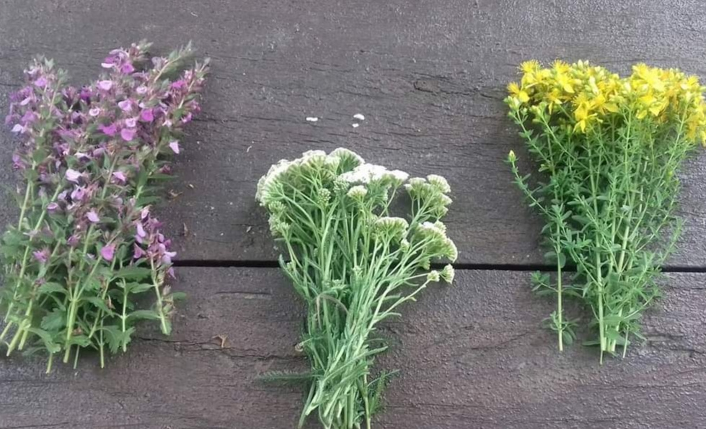
MEDICINAL HERBS
Medicinal herbs are a group of plants that contain substances that make them suitable for use for therapeutic purposes and for chemical-pharmaceutical purposes, or in the cosmetic and food industry.
In the world, about 12,000 out of 350,000 plant species are used for these purposes.

Slide 4
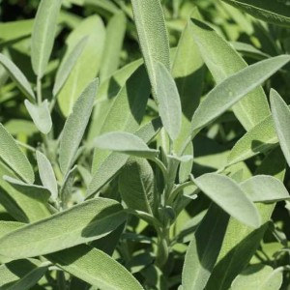
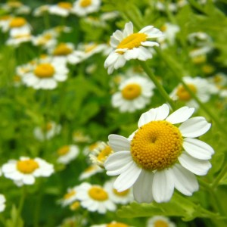
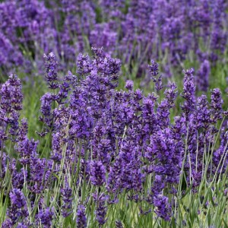
MEDICINAL HERBS OF CROATIA
In Croatia, there are more than 500 medicinal plants that are used in medicine, pharmacy, food and cosmetics industry
The most important are:
- sage
- chamomile
- basil
- rosemary
- mint
- lavander .....

Slide 5
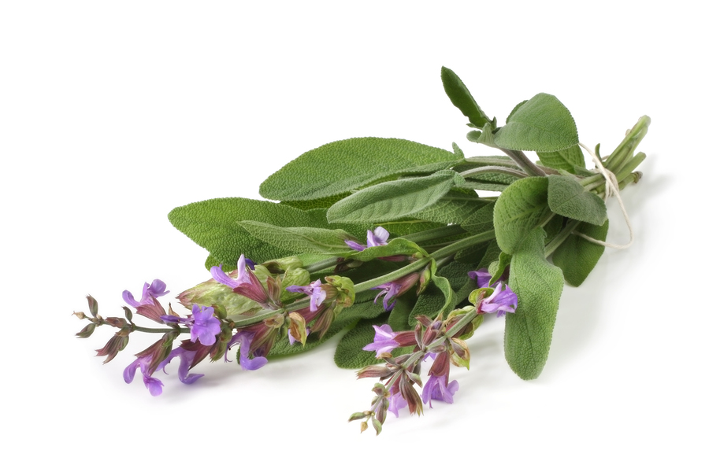
SOMETHING ABOUT - SAGE
Sage is most often used to obtain essential oils
Sage tea as a dressing for wounds and for rinsing the mouth and throat for disinfection.
It has a strong physiological impact on vital human organs.

Slide 6
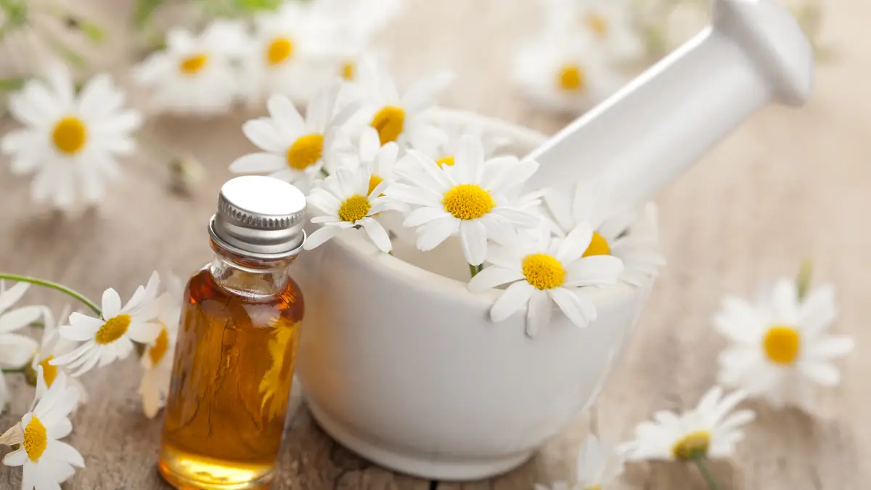
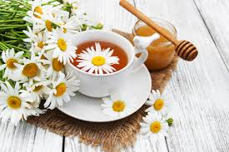
SOMETHING ABOUT - CHAMOMILE
Chamomile is an annual, wild plant spread all over the world.
It is rich in easily extracted essential oil.
It is recommended for patients suffering from stomach disorders, cramps, diarrhea, pain in the intestines

Slide 7
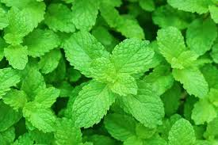
SOMETHING ABOUT - MINT
Mint is characterized by a pleasant menthol smell, and it is one of the most important medicinal plants for the production of essential oil, medicines and teas.
It helps prevent gum disease and bad breath, and drinking peppermint tea helps maintain oral health in general.
Mint has long been known to calm the digestive tract, reduce pain in the stomach and intestines, relieve various cramps and nausea, especially those caused by travel.

Slide 8
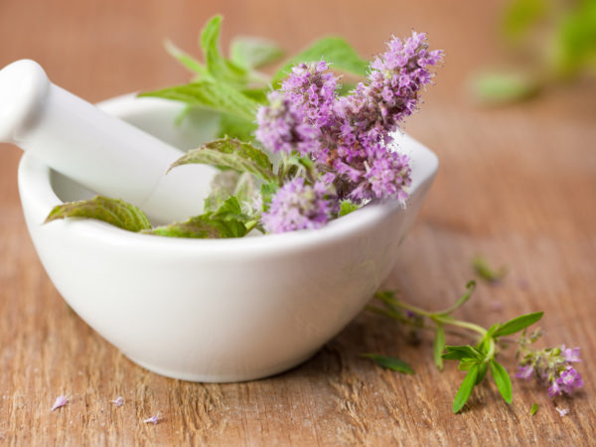
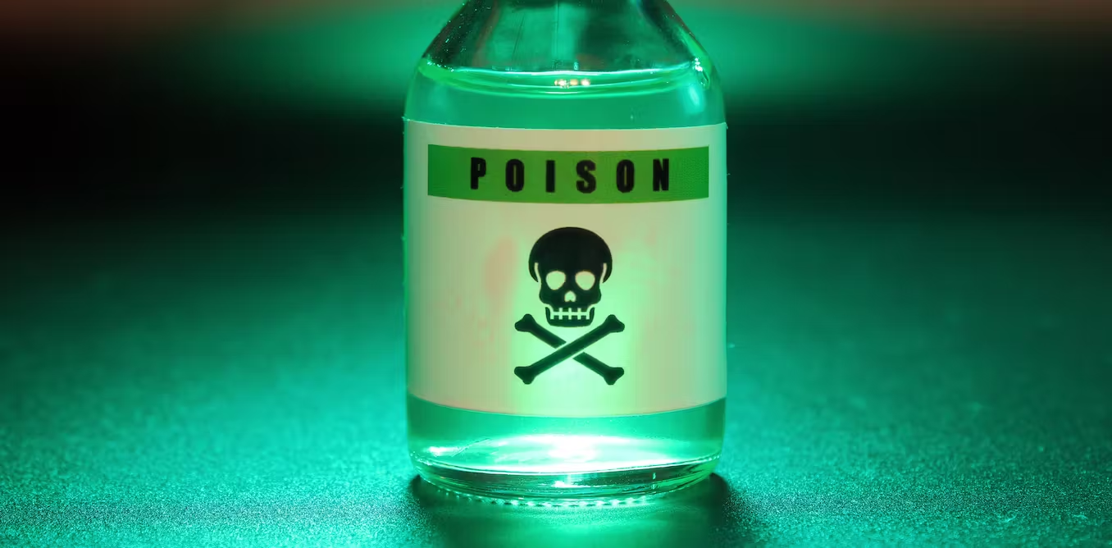
MEDICINAL HERBS - MEDICINE OR POISON
Whether a plant will be medicine or "poison" depends on:
- doses
- way of making
- allergies of the person
- picking place

Slide 9
SOURCES
https://tehnika.lzmk.hr/ljekovito-i-aromaticno-bilje/
https://www.enciklopedija.hr/natuknica.aspx?ID=37707
https://bs.wikipedia.org/wiki/Ljekovito_bilje
https://www.agroklub.com/sortna-lista/ljekovito-bilje/
https://www.naturala.hr/svaka-je-biljka-i-otrov-i-lijek/
https://hrcak.srce.hr/file/248836
https://www.adiva.hr/nutricionizam/ljekovito-bilje/kamilica-pomaze-kod-zelucanih-smetnji-grceva-proljeva-ali-to-nije-sve/
http://blidinje.net/najljekovitije-biljke-svijeta-kadulja/

Slide 10
THANKS FOR LISTENING!

