Slide 1
LIFE IN THE FUTURE

Slide 2
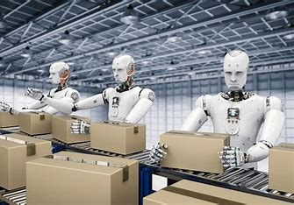
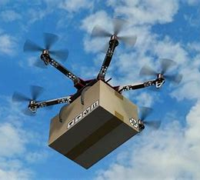
TECHNOLOGY IN THE FUTURE
I think that in the future there will be robots that will do our jobs.
I think robots will help us with the housework.
I think that there will be drones which will deliver our packages.

Slide 3
TRANSPORTATION IN THE FUTURE
I think that in the future there would be self-driving busses and cars.
I think there will be flying cars so that people can travel faster and easier.
I think there will be robot-guided planes.

Slide 4
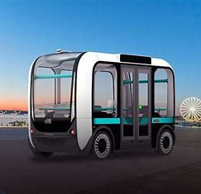
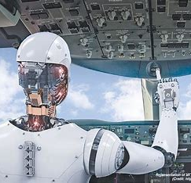
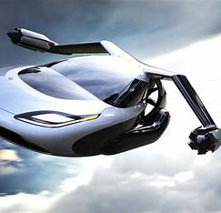

Slide 5
MEDICINE IN THE FUTURE
I hope that medicine will find cures for many diseases in the future.
I think that robots will do surgeries.
I hope that in the future everyone will have free access to the health services.

Slide 7
ACCOMODATION IN THE FUTURE
I think people will live and work in eco-friendly buildings.
I think people will colonize Mars and Moon.

Slide 8
FOOD AND WATER RESOURCES IN THE FUTURE
I hope everyone will have access to healthy food and clear water in the future.
I think people will have big skycreaper farms.
I hope we will eat healthier and organic food.
I think we will have diffirent sources of food in the future.

Slide 9
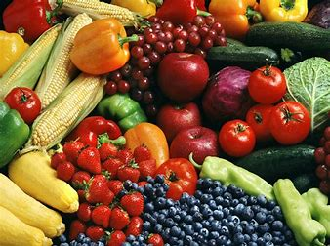
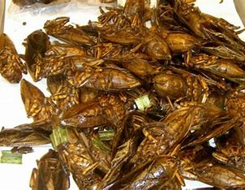

Slide 10
THANKS FOR YOUR ATTENTION!
Marko Kerum, 8.b

Slide 11
Sources:
https://th.bing.com/th/id/OIP.WQcRRU5hARWwDBcVeTg7JwHaEn?w=261&h=180&c=7&r=0&o=5&dpr=1.3&pid=1.7
https://th.bing.com/th/id/OIP.6MCS0k-UfSxEoTiD9T8IigHaEK?w=315&h=180&c=7&r=0&o=5&dpr=1.3&pid=1.7
https://th.bing.com/th/id/OIP.mLWuWLX44hJnPSRWw9V-gwHaEi?w=289&h=180&c=7&r=0&o=5&dpr=1.3&pid=1.7
https://th.bing.com/th/id/OIP.qlrxt33oXVhkqDo-Ms6gYgHaE8?w=273&h=182&c=7&r=0&o=5&dpr=1.3&pid=1.7
https://th.bing.com/th/id/OIP.MMmRRuRjZ_J95ayb1JafzgHaHa?w=151&h=180&c=7&r=0&o=5&dpr=1.3&pid=1.7

Slide 12
https://th.bing.com/th/id/OIP.MQS7GNd5LOhjx5xOezywqQHaD3?w=325&h=180&c=7&r=0&o=5&dpr=1.3&pid=1.7
https://th.bing.com/th/id/OIP.hPwH9wt37jMAihrldnvC2QHaFC?w=237&h=180&c=7&r=0&o=5&dpr=1.3&pid=1.7
https://th.bing.com/th/id/OIP.us7tCLytwb3slEyUQdtejQHaFQ?w=254&h=180&c=7&r=0&o=5&dpr=1.3&pid=1.7
https://th.bing.com/th/id/OIP.tRh2uJPA1YpP4sgLTvHqQQHaE8?w=233&h=180&c=7&r=0&o=5&dpr=1.3&pid=1.7
https://th.bing.com/th/id/OIP.cXzAqs3GQ-sAFDbD7jUgpgHaFj?w=260&h=194&c=7&r=0&o=5&dpr=1.3&pid=1.7

