Slide 1
My dream house
Lana Bralić 5.b

Slide 2
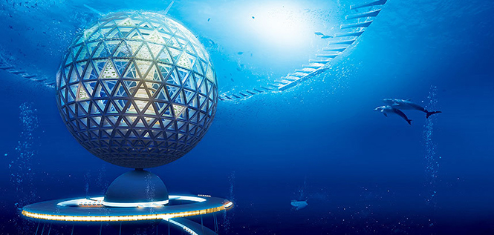
My dream house is under the sea in the middle of the ocean. It is made of glass.

Slide 3
Inside the house there are four rooms:a living room,a bedroom,a kitchen and a bathroom. In the living room there is a sofa,big TV and lots of sea plants. In the kitchen there is a small table and four chairs. In the bedroom there is a bed and a big mirror decorated with shells. My favourite room is my bedroom.

Slide 4
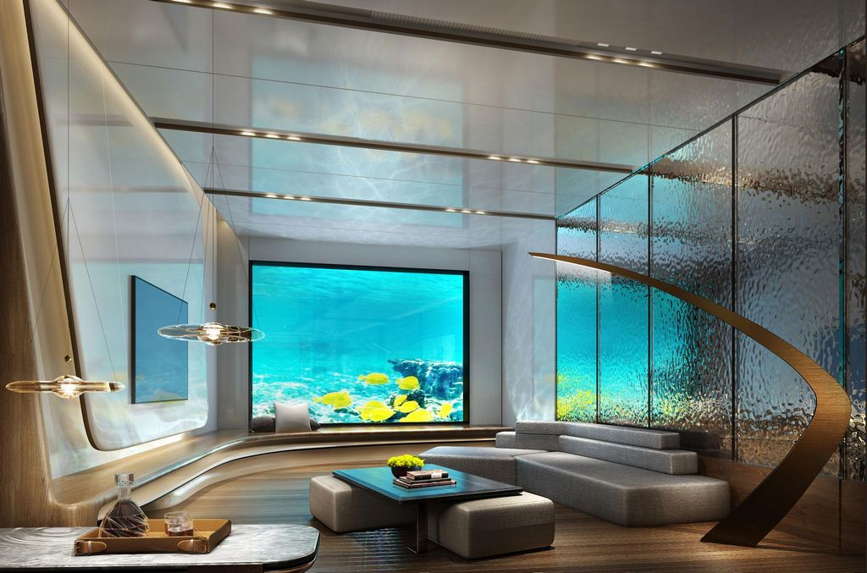

Slide 5
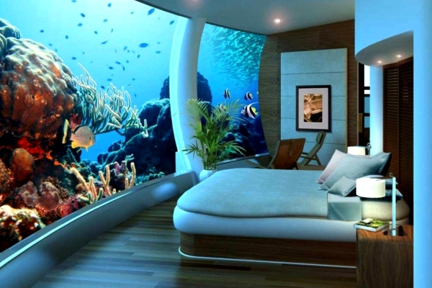

Slide 6
https://www.google.com/search?q=ku%C4%87a%20na%20dnu%20moru&tbm=isch&tbs=rimg:CQIoMenpB2sEYbFUCGqraQDWsgIOCgIIABAAOgQIABAAQAE&hl=hr&sa=X&ved=0CBoQuIIBahcKEwjQi5qCjMr8AhUAAAAAHQAAAAAQCA&biw=1349&bih=600
Source

Slide 7
Thank you for your attention

