Slide 1
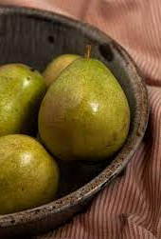
PEAR
Iva Žižić
5.b

Slide 2
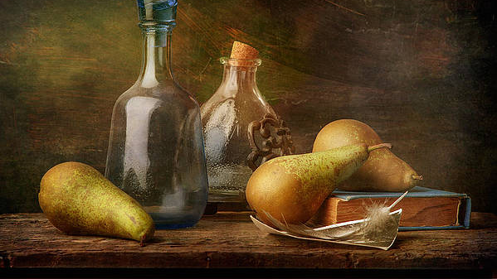
The origin of the pear
Pear is a plant of the Rosaceae family, which has fruits of the same name. It has been cultivated for more than 4000 years, because of its edible fruits. It originates from Asia. Today it grows all over Europe

Slide 3
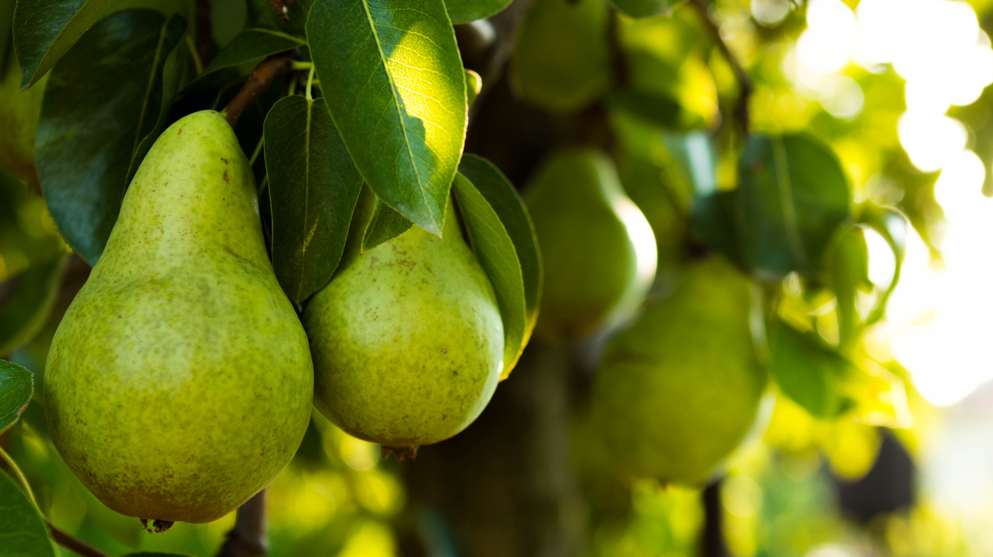
Description of the pear tree
It is a tree that can grow over 20 m. Its leaves are ovate and simple, usually with a slight edge. Its fruits are yellow or green, ripen from the beginning of autumn to the beginning of winter, depending on the species. The fruits are rich in minerals: potassium, phosphorus, calcium, magnesium, iron, chlorine, sulfur and numerous microelements. It has a lot of vitamins, especially vitamins A, C, E, most vitamins from group B, H and D.

Slide 4
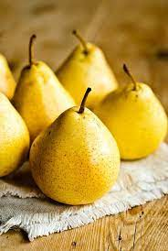
Pear is good for:
It is rich in fiber
Cleanses the body and sheds pounds
Protects against diabetes and heart diseases
It strengthens immunity and relieves inflammation
It takes care of the skin
Protects vision

Slide 5
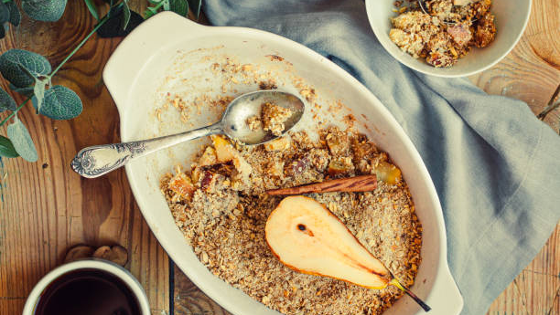
Pear crumble
Ingredients: Preparation: -Heat the oven to 180°C
6 pears - Slice the pears and add them
120g brown sugar in a pan with the lemon juice
1/2 lemon, squeezed and sugar for 5 to 10 minutes
Dressing: - Then make the dressing, chop all
100g flour ingredients, put the flour, sugar
50g almonds and butter in a large bowl then
75g sugar mix until they become like
75g butter breadcrumbs
½ teaspoons of ground ginger and cinnamon - Put the prepared pears in the
1 pinch of ground cloves and sea salt mold and sprinkle the dressing
On it

Slide 6
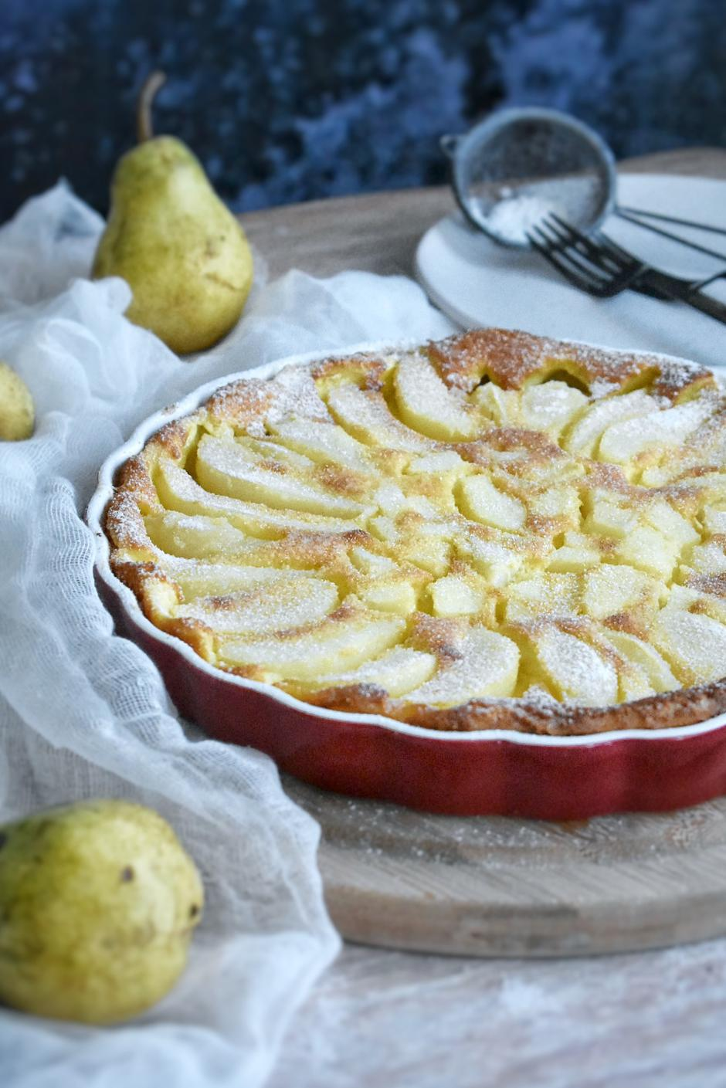
Pear pie
Ingredients: -Preparation:
55g melted butter -Peel, clean and cut the pears
3 eggs into pieces , then in the mold
- Put the other ingredients in
1Pinch of salt a mixer, put the mixure on a pears
180 ml milk (in the mold) and bake for 40-45
65g sugar minutes
40g flour - Let it cool a little bit,sprinkle with
2 vanila sugar powdered sugar
4 pears
Powdered sugar

Slide 7
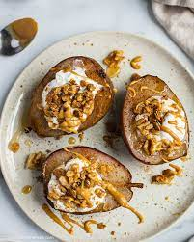
Baked pears with honey and walnuts
Ingredients: -Preparation:
2 ripe pears - Heat the oven to 180
¼ teaspoon of cinnamon - Cut the pears and place
2 tablespoons of honey them on a baking paper
30 g of crushed walnuts - Sprinkle them with
Cinnamon and fill with nuts
And honey
- Bake for about half an hour
- Decorate with dried fruit

Slide 8
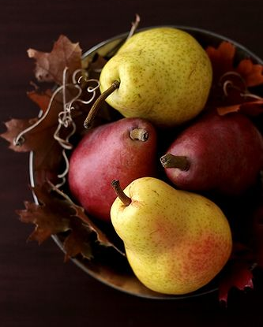
Sources
https://en.wikipedia.org/wiki/Pear
https://gastro.24sata.hr/kolumne/super-jednostavni-desert-s-kruskama-24297 - gastro.24sata.hr
https://gastro.24sata.hr/recepti/zasladite-se-pecenim-kruskama-s-orasima-i-medom-24195 - gastro.24sata.hr
https://gastro.24sata.hr/recepti/isprobaj-sezonski-mrvicasti-kolac-s-kruskama-26441 - gastro.24sata.hr

Slide 9
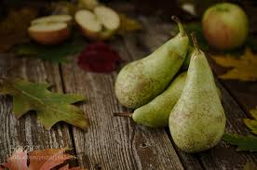
THANK YOU FOR YOUR ATTENTION!!

