Slide 1
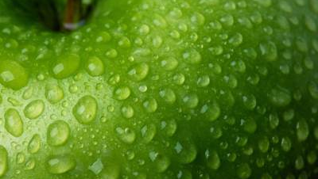
PEAR
Noa Tešija, 8.b

Slide 2
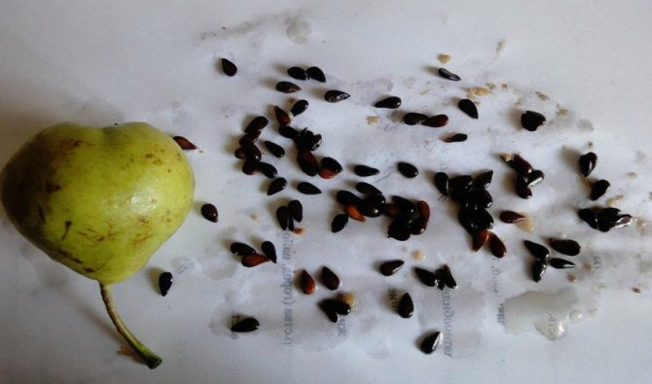
Genus of plants from the Rosaceae family.
It is an angiosperm, which means that the seed in the flower is in the pistil.
When the flower turns into a fruit, it is inside the fruit .

Slide 3
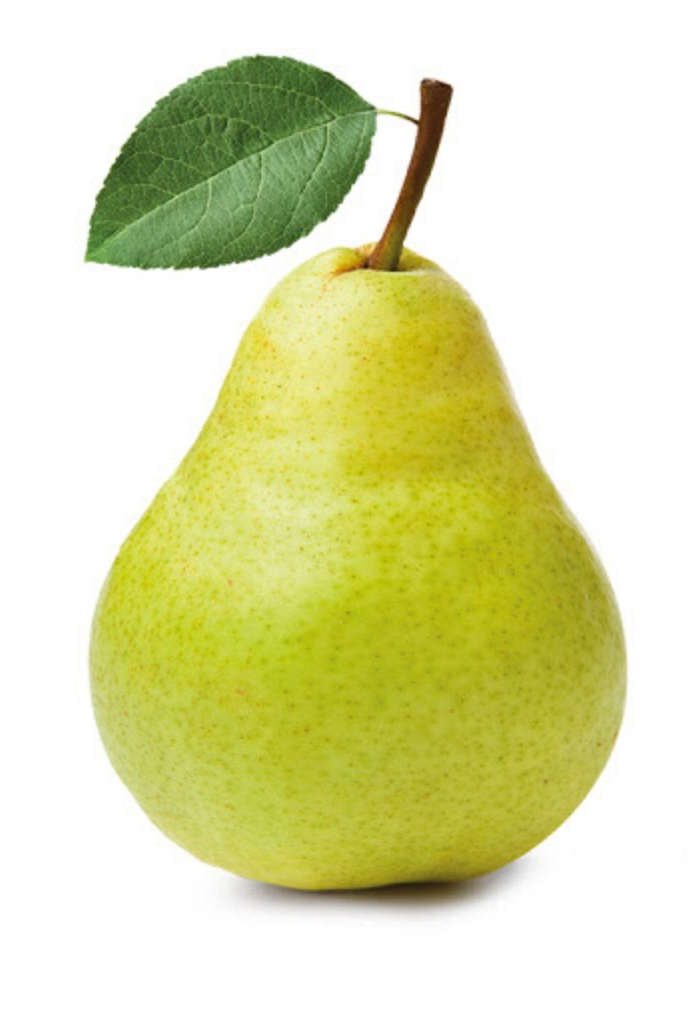
PEAR FRUIT :
The pear fruit consists of a stalk, neck (narrow part) and body (thick part).
At the very bottom is the calyx.

Slide 4
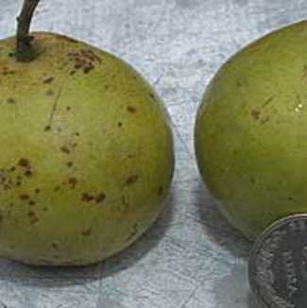
TYPES OF PEARS :
There are 72 types of pears, and the most famous are “tepka”, “batuga” or “gnjilača”
Some other types of pears are : Abbe fetel, Angelina, Augustinka, Babushka, Bonte…

Slide 5
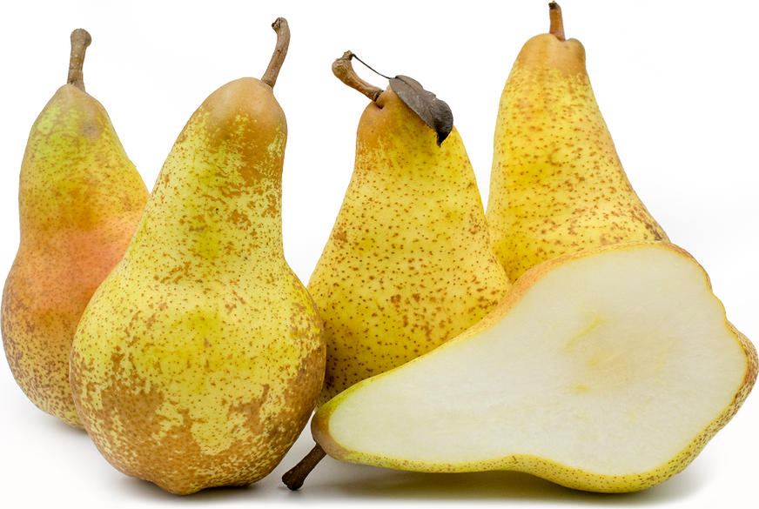
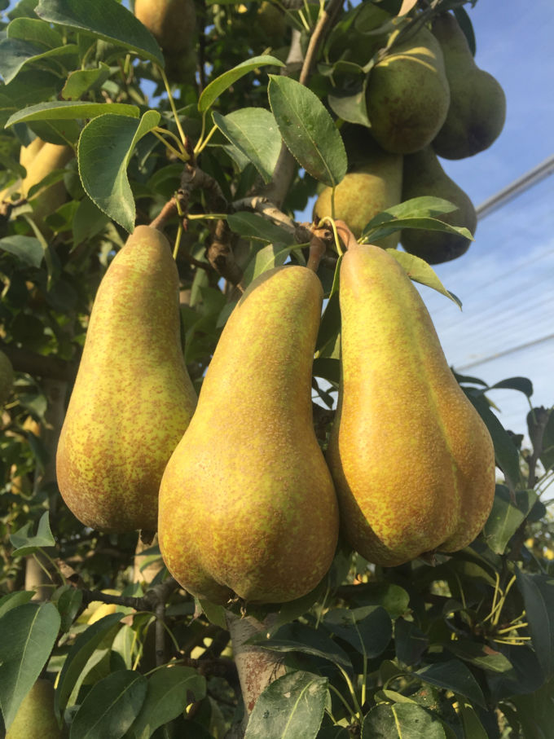
ABBE FETEL :
Abate or Abbe fetel is a variety of European pear.
It is origianally from France.
It was named after Abbot Fetel, who acquired it.
He began working on it in 1865, while he was priest of Cheesy, Rhone, using several local cultivars as a starting point.

Slide 6
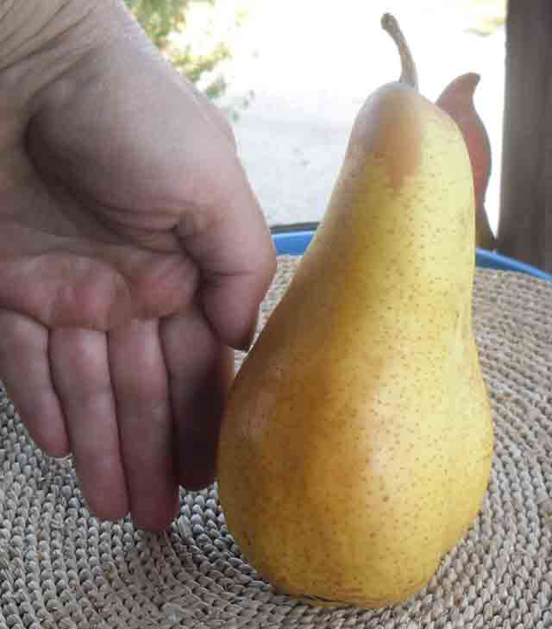
ANGELINA :
Pear Angelina is extremely beautiful, yellow with a little brown surface.
About 15 cm long and large 350 g
The meat is very sweet and juicy
It ripens at the end of September
The petiole is short and thick

Slide 7
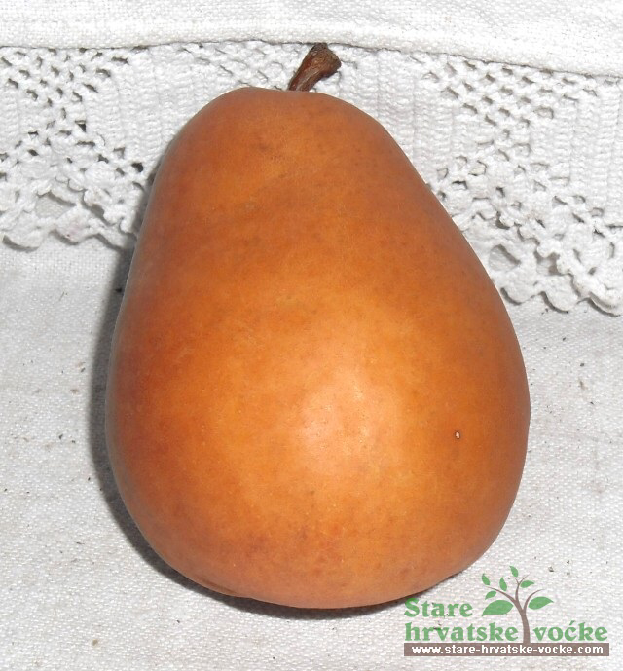
AUGUSTINKA :
Augustinka is a medium-sized to large pear, with a golden brown skin that is soft.
The flesh of this beautiful pear is very juicy, sweet with fine structure of the flesh.It is very tasty, it has just enough acid to refresh and give the sweet note an expressiveness.
The tree is located in Koprivnica
This variety belongs to the summer-autumn varieties.

Slide 8
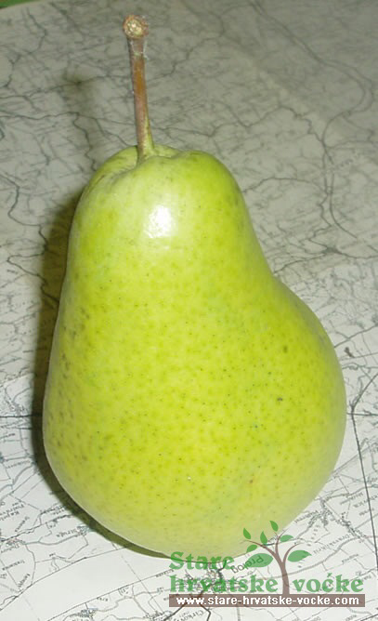
BABUSHKA :
350 g
The meat is soft, white and very fine

Slide 9
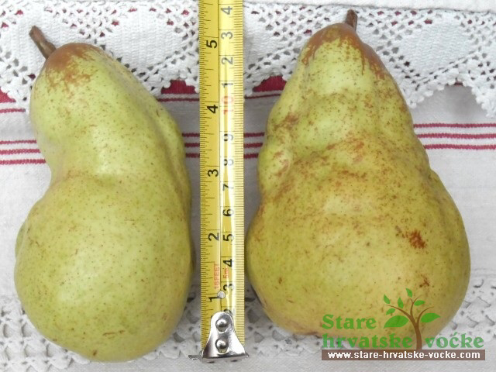
BONTE :
Bonte is an extremely large pear
527 g
Irregular pear-shaped
It is very tasty when it is not fully ripe, it is yellow, juicy, sweet and has yellow flesh
The old tree of this pear is in Cvetkovac

Slide 10
SOURCES :
https://hr.m.wikipedia.org/wiki/Kru%C5%A1ka
http://www.stare-hrvatske-vocke.com/kruske.html

Slide 11
THANK YOU FOR ATTENTION!!!!
Noa Tešija, 8.b

