Slide 1
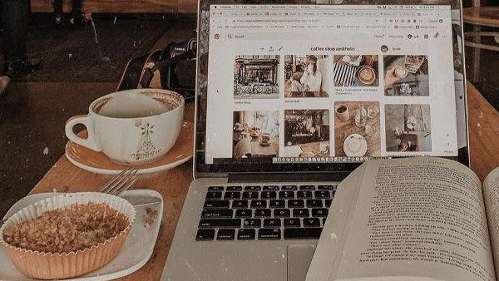
𝐩𝐫𝐨𝐬 𝐚𝐧𝐝 𝐜𝐨𝐧𝐬 𝐨𝐟 𝐮𝐬𝐢𝐧𝐠 𝐦𝐨𝐝𝐞𝐫𝐧 𝐭𝐞𝐜𝐡𝐧𝐨𝐥𝐨𝐠𝐲 ˚⸙͎۪۫⋆
Cvita Grubišić 7.b.

Slide 2
Disclaimer ヽ｀、ヽ｀
None of the pictures I used are mine, I found them on Pinterest and used the ones that look the most similar to things I own (in first few slides, the rest are random)
At places where I didn’t mention the source, that’s something that I knew beforehand (sources will be mentioned in the end)
At first, I might seem like I’m taking this as a joke, but I’m 100% serious and these are just my opinions you don’t need to agree with

Slide 3
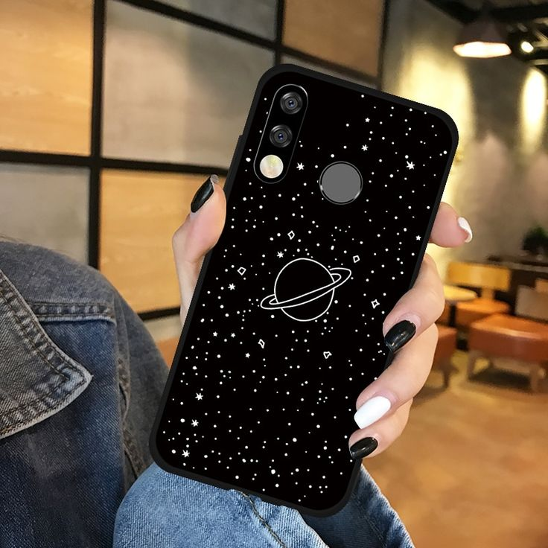
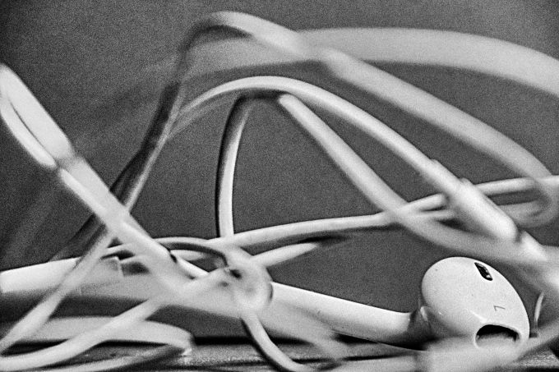
Technology i use (ꈍᴗꈍ)
My phone (the model is Huawei P40 Lite E)
I usually use it for fun, researching, texting, watching YouTube videos and listening to my playlists of weird music
School tablet (the model is C20)
I use it for school, watching horror movies and anime
Laptop (some old Windows, I think Windows 2007)
I sometimes use it for watching series, movies and art videos on YouTube
I use earbuds since I’m too broke for Bluetooth headphones or Airpods

Slide 4
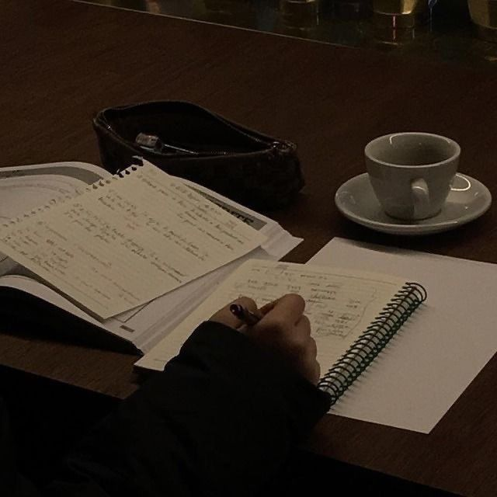
Time spent on technology ••̩̩͙⊰
I use my school tablet mainly during school hours, yet sometimes I use it in the afternoon to watch funny YouTube videos.
I spend a LOT of time on my phone. Honestly, I should start using it less and have time for myself without being attached to Internet dramas.
I do use technology a lot in my daily life, so I really should spend more time reading and taking walks (since it’s probably better for my mental health).

Slide 5
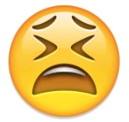
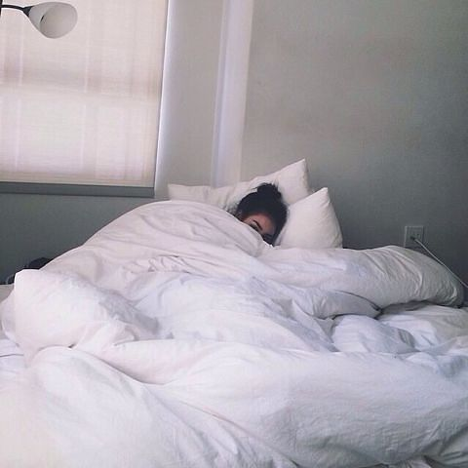
What HAS my health lost for the villain named technology ❅｡.
My back tends to hurt a lot due to all of the bizzare positions I’m in during school hours and my free time.
Sometimes, I experience pain in my abdomen, especially if I have period cramps so I’ve decided to be a lazy potato and lay in my bed with my limbs everywhere and my phone tangled in that mess.
My wrist, my neck and my head hurt a lot, especially when I’m doing my assignments at night or when I just spend way too much in front of these monstrous screens.
this girl is honestly me during my period

Slide 6
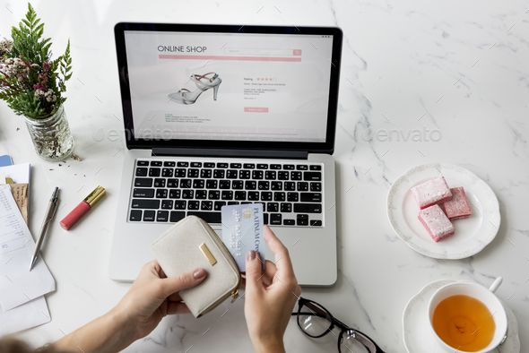
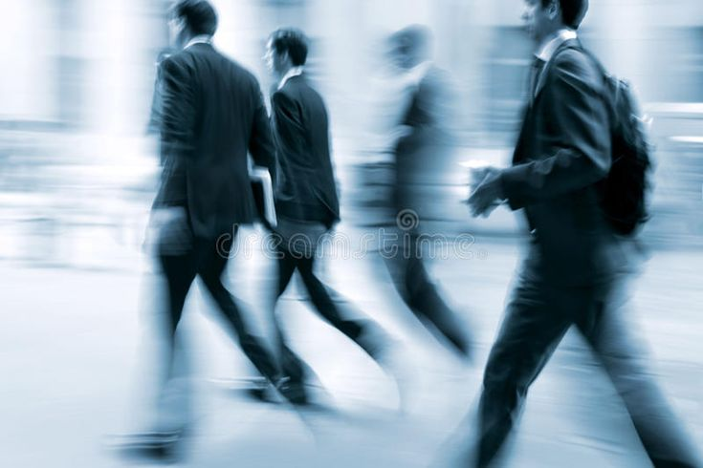
And what about Our daily lives? ༅༅༅༅༅༅༅༅༅༅༅༅
As we live in 21st century, we can’t imagine our lives without technology
Everything with modern technology is simplified, easy to access, with touch screens, with more eco-friendly solutions etc.
The more some things become common, they will be cheaper and easier to find
You can do online shopping, browse for news, listen to music, make calls, organize your schedule, play videogames, text a friend and many other fun things

Slide 7
And what doctors say? ु
According to American Optometric Association (AOA) using technology way too much can lead digital eye strain (symptoms being blurred vision, dry eyes, headaches, neck and shoulder pain)
A study from 2017 says that addictons to phones can cause serious neck problems, since your head is in an unnatural position (the same goes for shoulder and spine problems; to get rid of this you should fix your posture, get an ergonomic chair or other and take frequent breaks to stretch)
According to National Sleep Foundation, using your phone before going to bed can physiologically and psychologically affect your sleeping

Slide 8
And what doctors say? ु
Some studies show that people who use socially media a lot are more isolated from the world; problematic Internet use can lead to depression, substance use and anger issues, boys tend to be less aware of this; media’s influnce can also lead to anxiety, body dysmorphia or dysphoria, eating disorders and other mentall illnesses
Children who use technology from very young age can have behaviour issues, less time to play and loss of social skills, obesity, sleep problems and violent behaviour
Other than us, technology also affects our environment, which results are water and air pollution, deplotion of natural resources and extincion of many animals and plant species

Slide 9
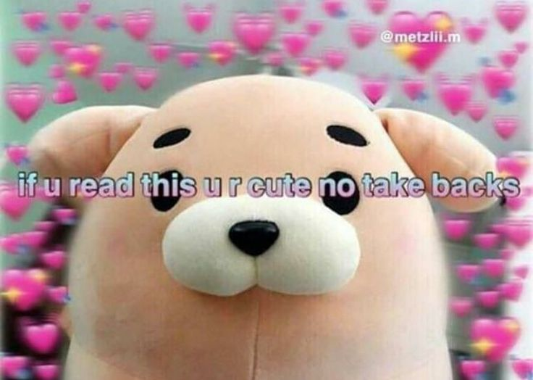
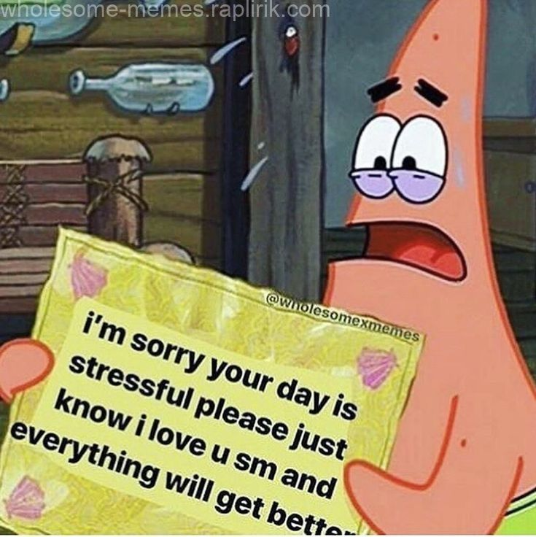
My opinions o(≧∇≦o)
Technology is necessary for our lifestyle, but we still need to use it corectly and frequently take brekas from it
If it’s really affecting someone’s health in a bad way, they should see a doctor since we don’t want it to get worse
It’s useful and I like it, but everything has it’s limits
There are many bad people out there, so everyone should be careful using the Internet and social media, especially if they are a minor

Slide 10
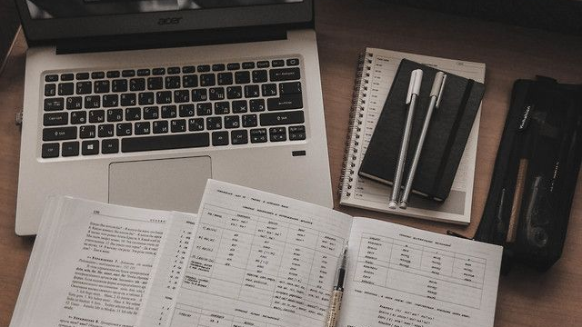
My sources (≡^∇^≡)
my head duh
Edinburgh Sensors (website) https://edinburghsensors.com/news-and-events/impact-of-technology-on-the-environment-and-environmental-technology/
Healthline (website) https://www.healthline.com/health/negative-effects-of-technology

Slide 11
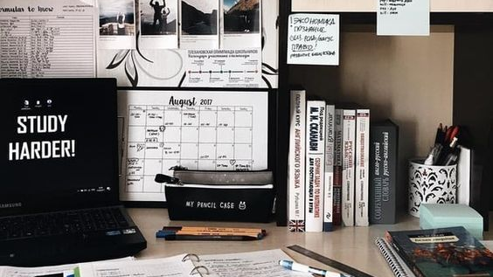
𝓽𝓱𝓪𝓽'𝓼 𝓪𝓵𝓵 𝓯𝓸𝓵𝓴𝓼 :D

