Slide 1
Dalmatian bell
Manuela Melvan 7.b

Slide 2
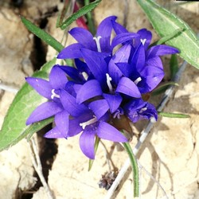
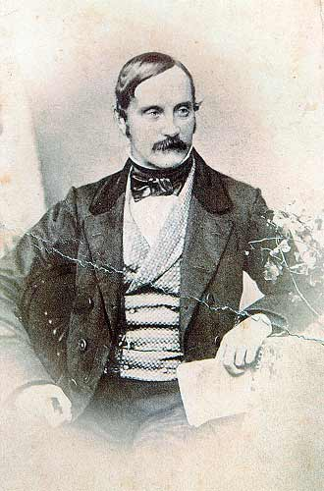
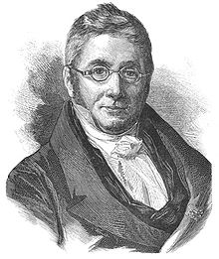
Interesting facts
The Dalmatian bellflower (lat. Edraianthus dalmaticus) is an endemic plant from the Campanulaceae family.
The species was first described by A. De Candolle (Augustin Pyramus de Candolle) in 1830, in the vicinity of Solin.In 1847 Roberto de Visiani found the plant in the vicinity of Klis.
Roberto de Visiani
A. de Candolle

Slide 3
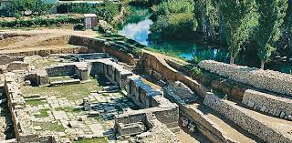
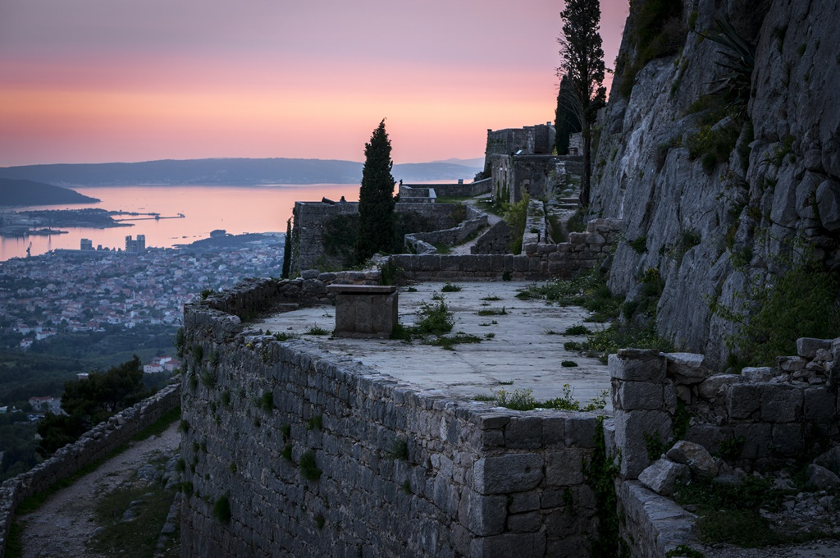
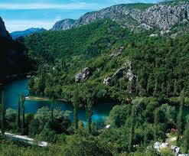
Prevalence
It grows in the vicinity of Klis, Solin and Drniš, on the slopes of Promina, in Vrličko and Sinjsko polje, in the Cetina canyon and on the northern slopes of Mosor.
Klis Solin
Cetina (canyon)

Slide 4
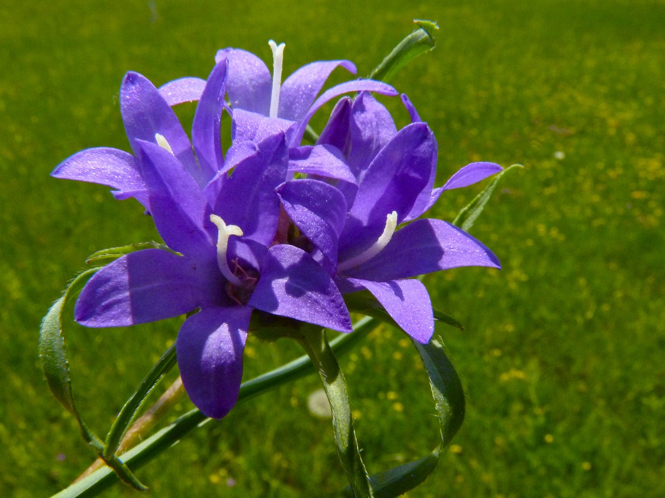
Look
It is a perennial plant, adjacent, rosette or loose-shaped.
It blooms two to five times a year, propagated by seeds.
The lobes of the calyx are broadly triangular, of equal width and length.
It has inflorescence leaves significantly above the head. The quiver opens irregularly inside the cup.
The flowers are in glabrous inflorescences, which are surrounded by sheath leaves.

Slide 5
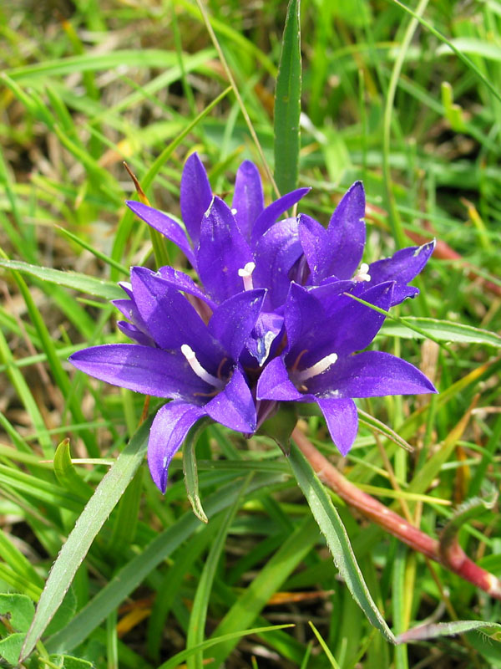
Ecology of the species
It is a heliophilic plant.
In the northern part of the range, it grows on moist, flooded or swampy meadows of karst fields, which are under water for most of the year, and dry up only in summer.
In the southern part of the range, they grow in dry rocky places, on rocky pastures.
Suitable soils are loam and diluvial clays.

Slide 6
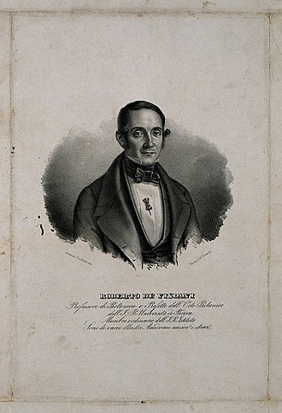
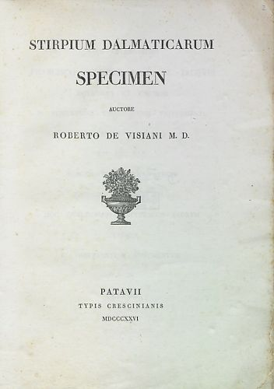
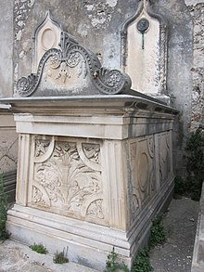
Roberto de Visiani
Roberto de Visiani (1800-1878) (in Croatian: Robert Visiani) was an Italian botanist, naturalist and scholar. He is seen as one the fathers of modern botany in Italy.
The standard author abbreviation Vis is used to indicate this person as the author when citing a botanical name.
The tomb of Roberto de Visiani in Sibenik.
His "Flora Dalmatica" is remembered on the front frieze.

Slide 7
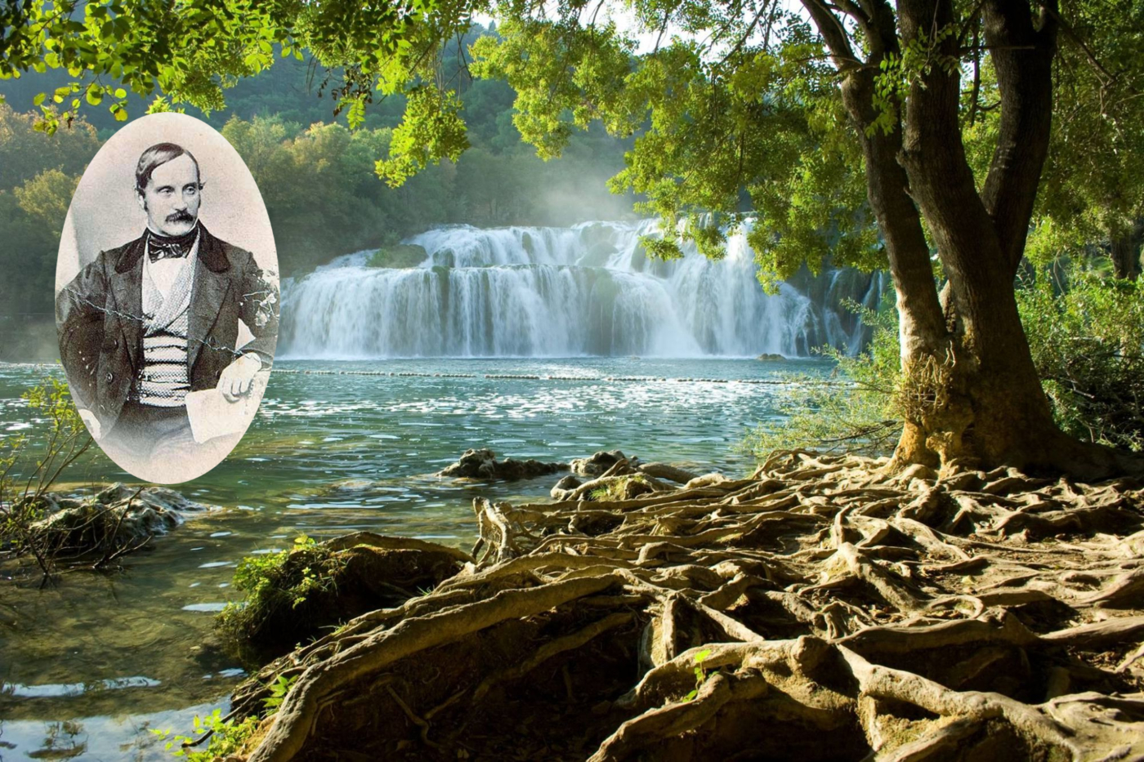
In Dalmatia
Roberto Visiani wrote the work "Flora Dalmatica" in the period from 1837 to 1878.
In three volumes, he processed 2250 plant species.
For the first time, he described 60 species and 5 new genera of plants.
He was the first to record the riga Bekmania in the area of Drniš and found the endemic plant Dalmatian bell in the vicinity of Klis.

Slide 8
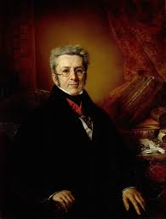
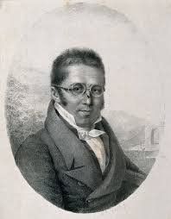
Augustin Pyramus de Candolle
Augustin Pyramus (or Pyrame) de Candolle,4 February 1778 – 9 September 1841) was a Swiss botanist.
René Louiche Desfontaines launched de Candolle's botanical career by recommending him at an herbarium.
Within a couple of years de Candolle had established a new genus, and he went on to document hundreds of plant families and create a new natural plant classification system.

